Slide 1


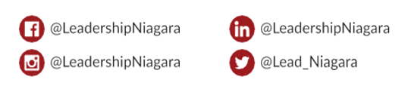
Welcome to #CLDP2425
In Partnership With
Follow & Tag

Slide 2

Land Acknowledgement
I would like to begin by acknowledging that the land on which we gather today has been the traditional territory of indigenous peoples for countless generations; most recently by the Anishinaabeg and Haudenosaunee Peoples through the Dish with One Spoon Wampum Belt, an agreement to peaceably share and care for the resources around the Great Lakes.
This wampum predates Treaty 3 of the Upper Canada Treaties, highlighting the tremendous contribution these nations have made to our shared history Today we would like to acknowledge these contributions and how thankful we are, that today, we are able to share this land with them.
Notes:
Ann

Slide 3

Day One Sponsor

Slide 4
Opening Retreat and Day One
Learning Objectives
Develop an understanding of the Leadership Niagara (LN) journey and all program expectations,
Identify learning goals for their personal and professional growth as a community leader,
Network with LN team members and commence the development of a community of learners,
Examine foundational principles of leadership; analyze and assess one's personal leadership strengths and opportunities,
Explore strategies for maximizing inclusion and leveraging the strengths of self and team, and
Develop an understanding of the Experiential Learning Project requirements and expectations for CLDP
Notes:
Ann to review

Slide 5
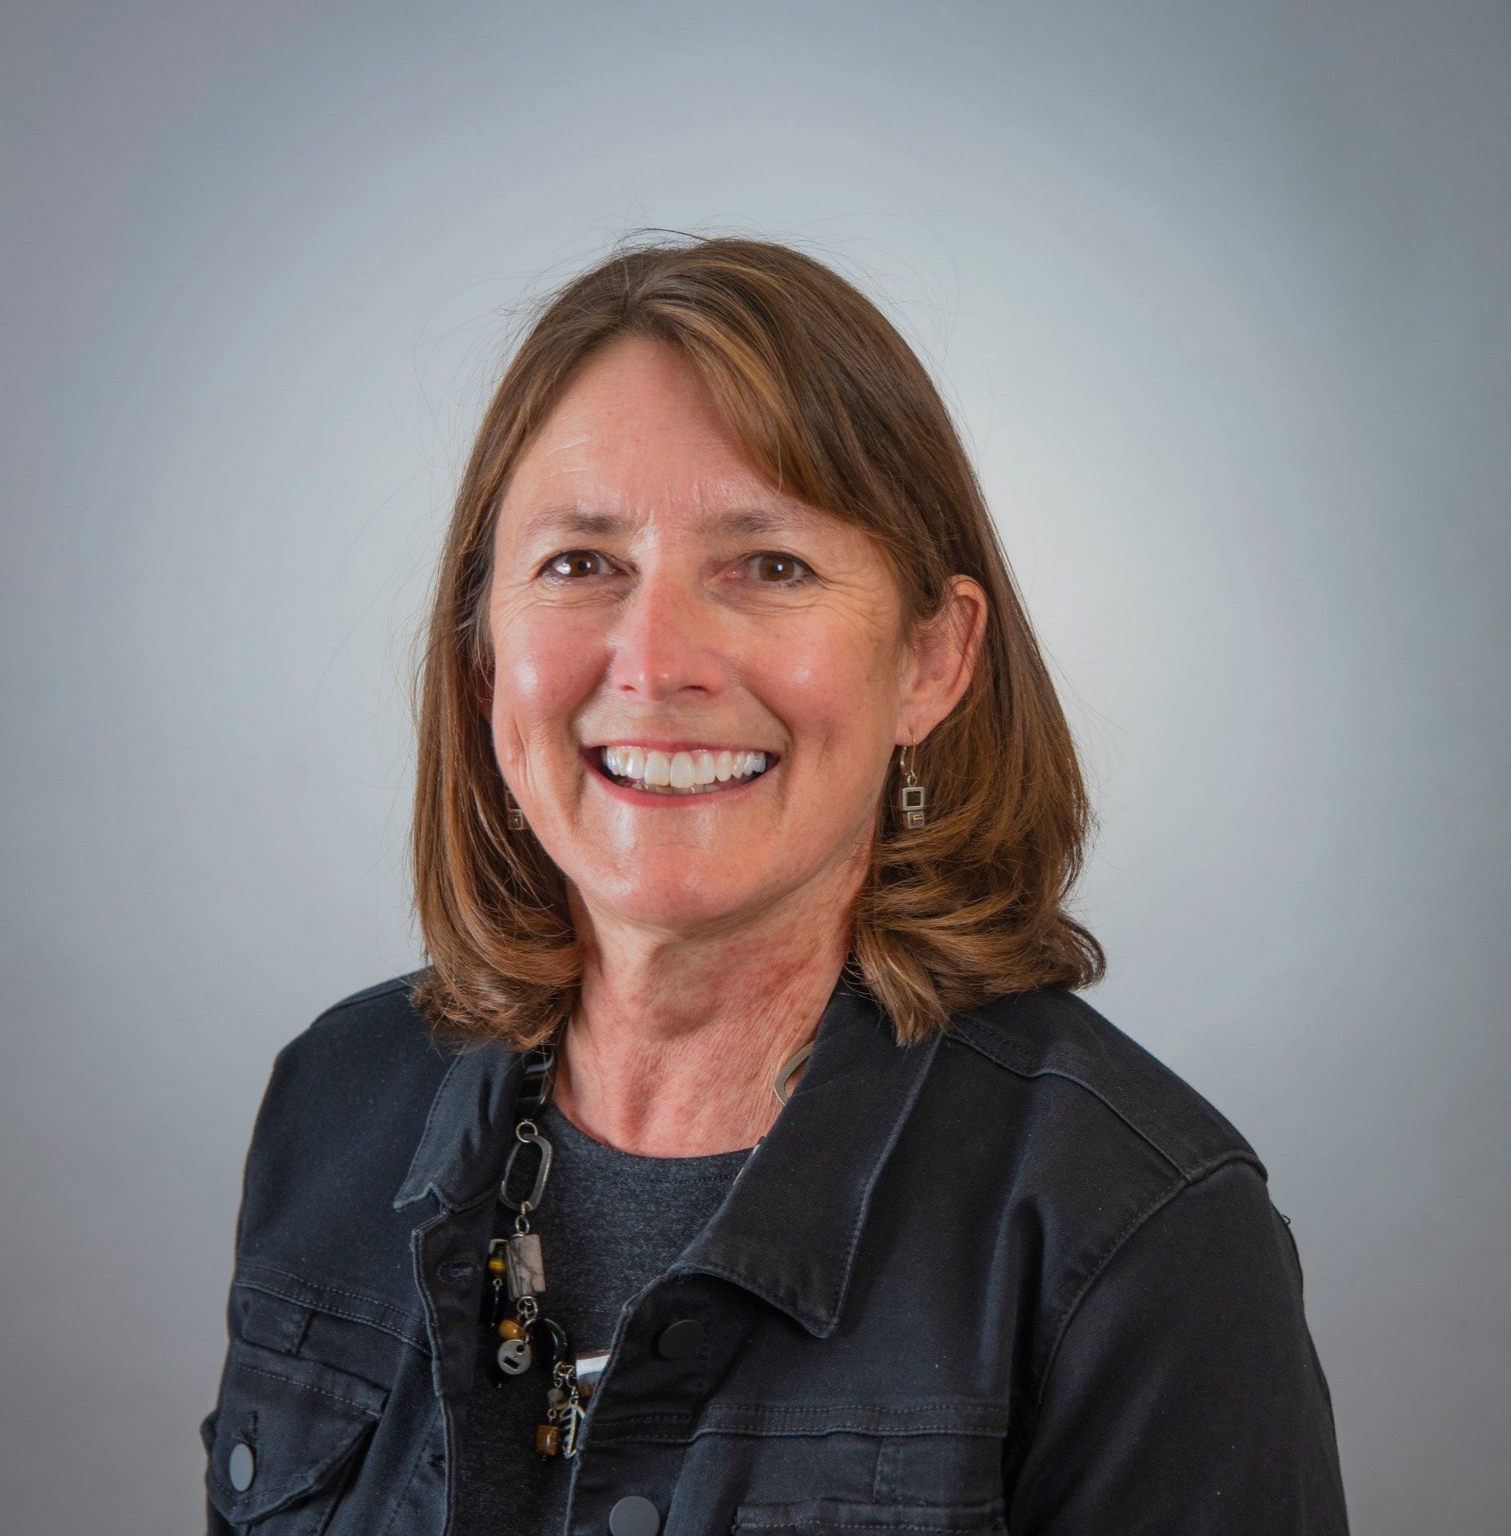
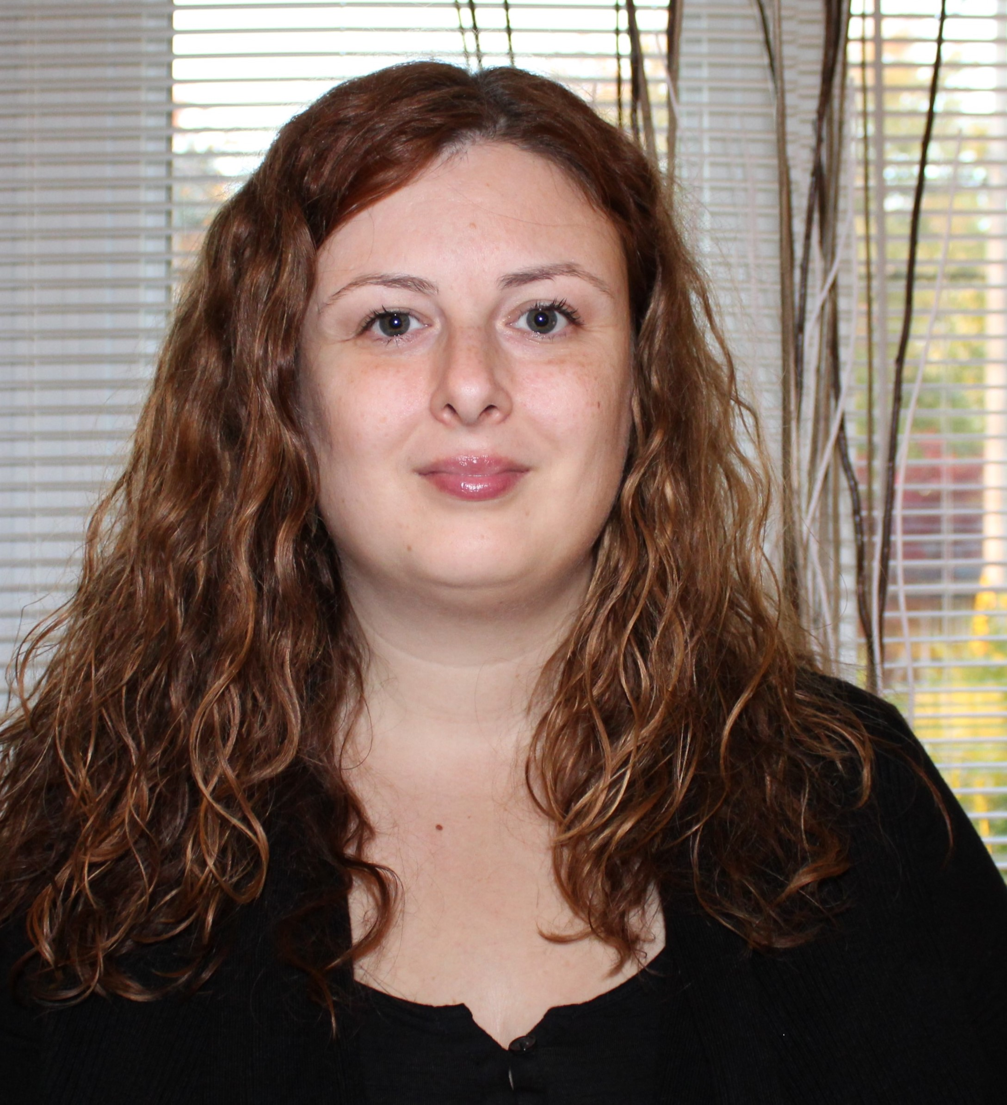
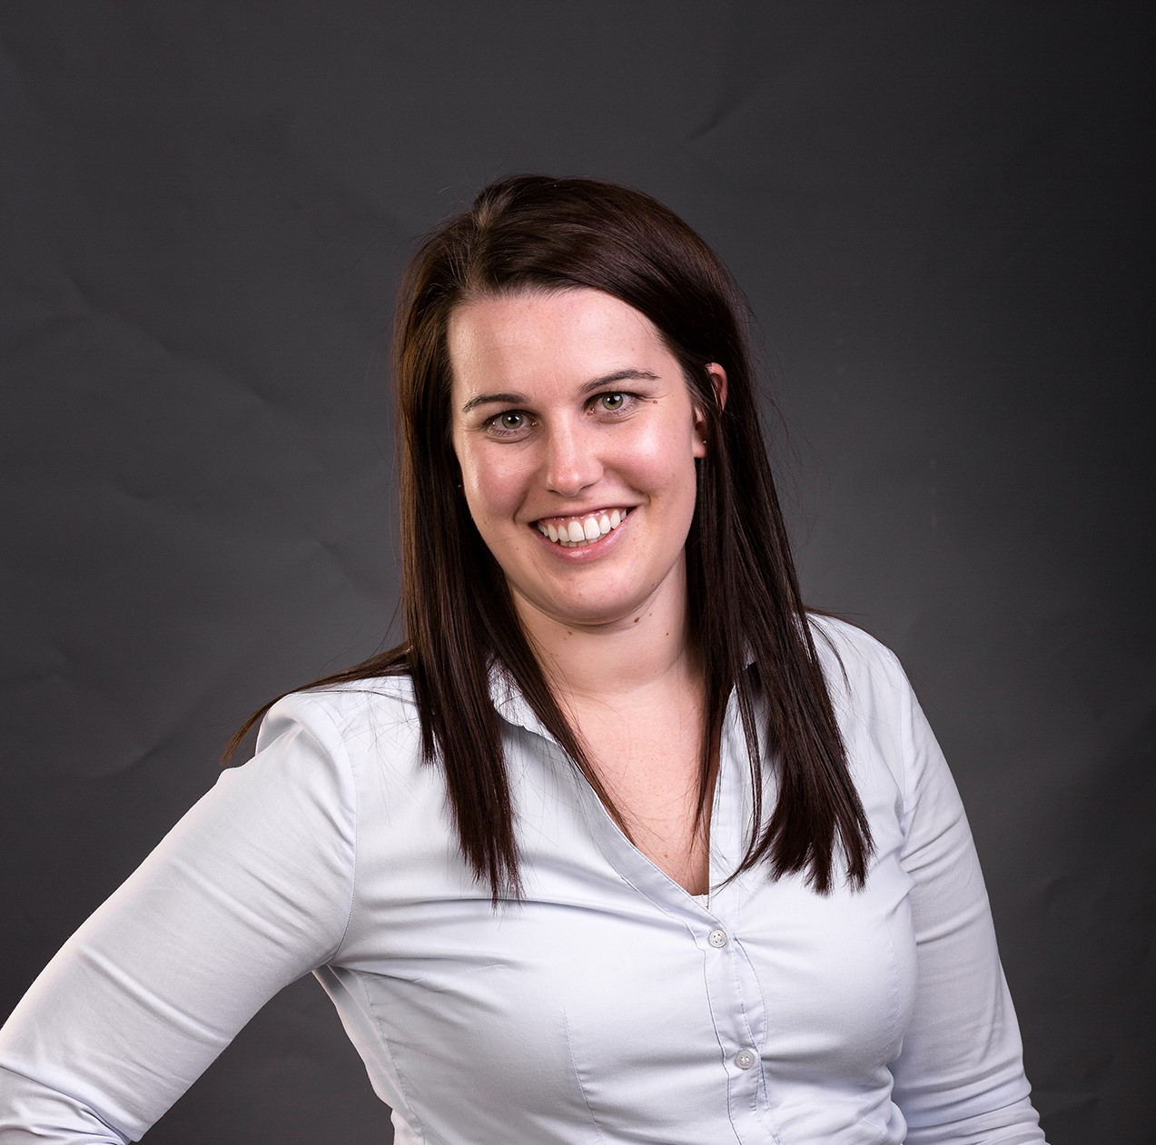
Program Advisory Day 1 Committee
Ann Harrison (chair)
Katie McQuestion
Carrie Price
Notes:
Terry introduces

Slide 6
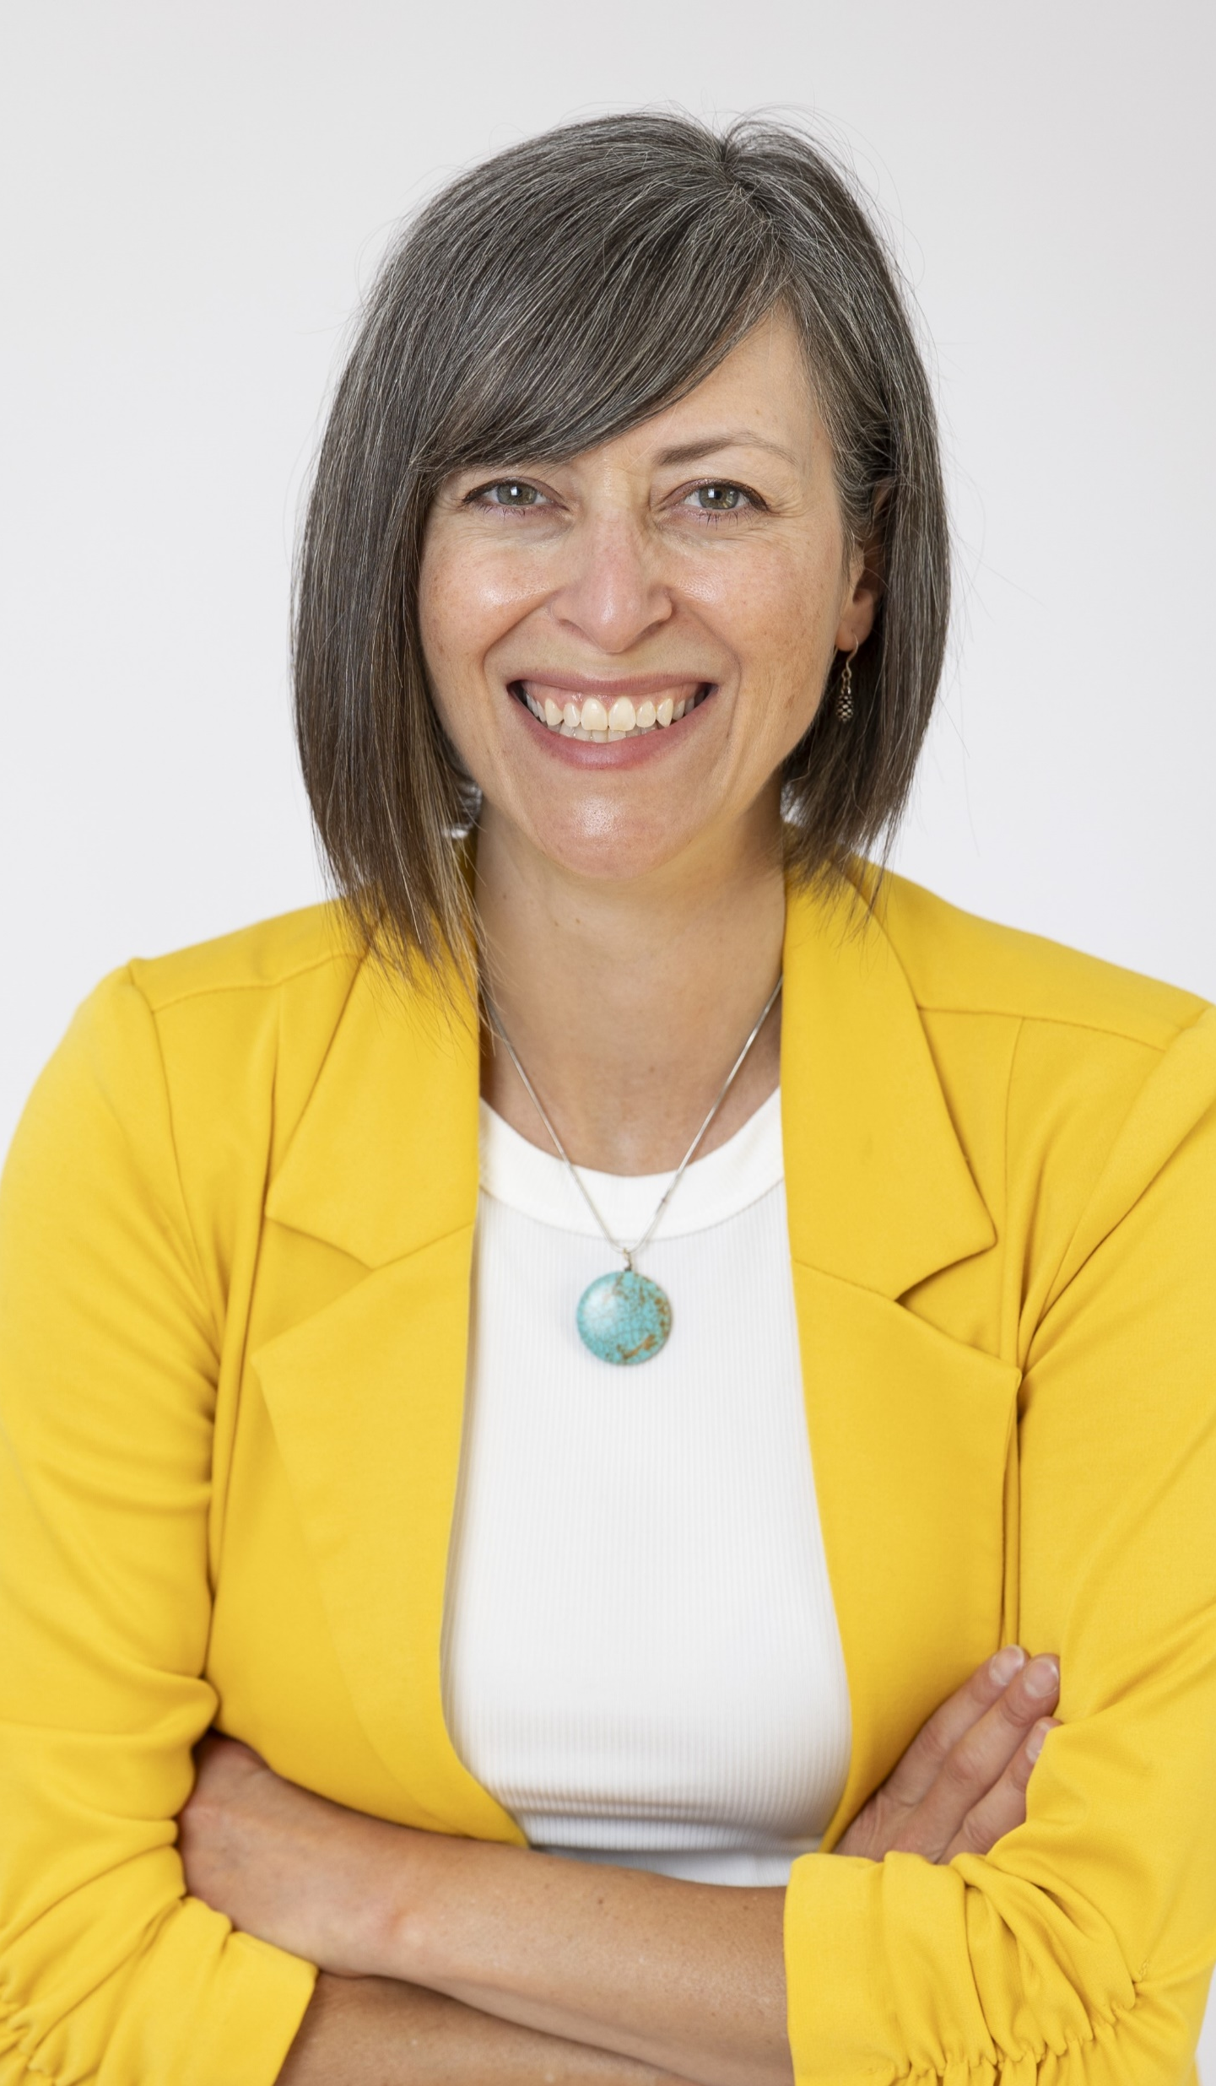
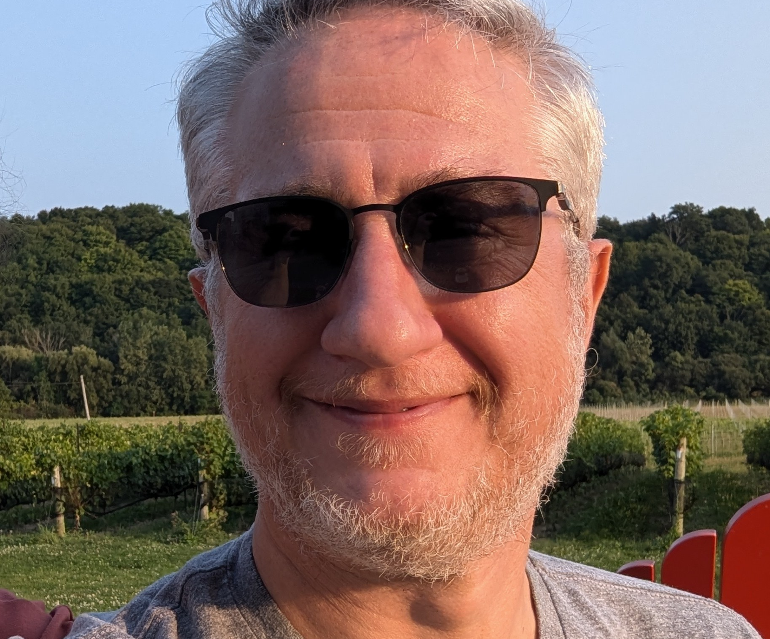
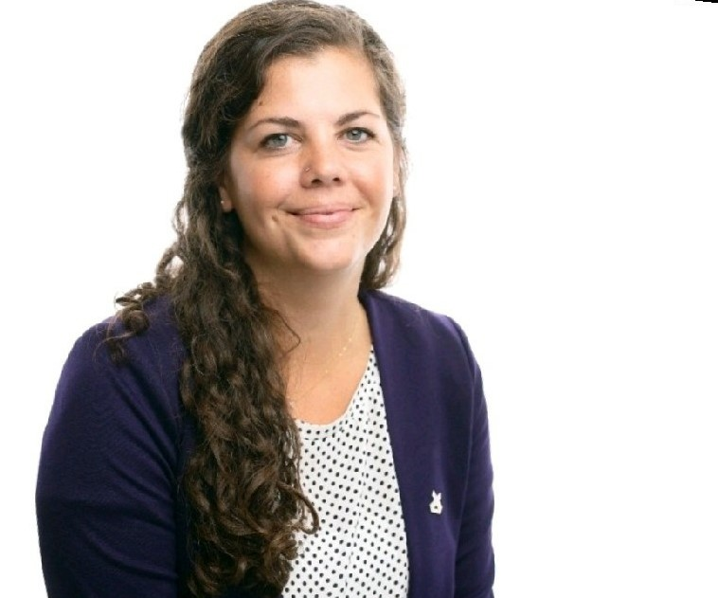
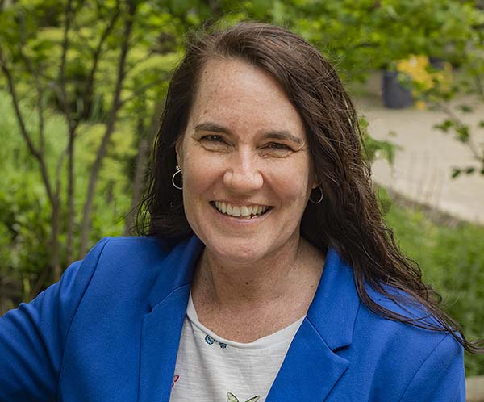
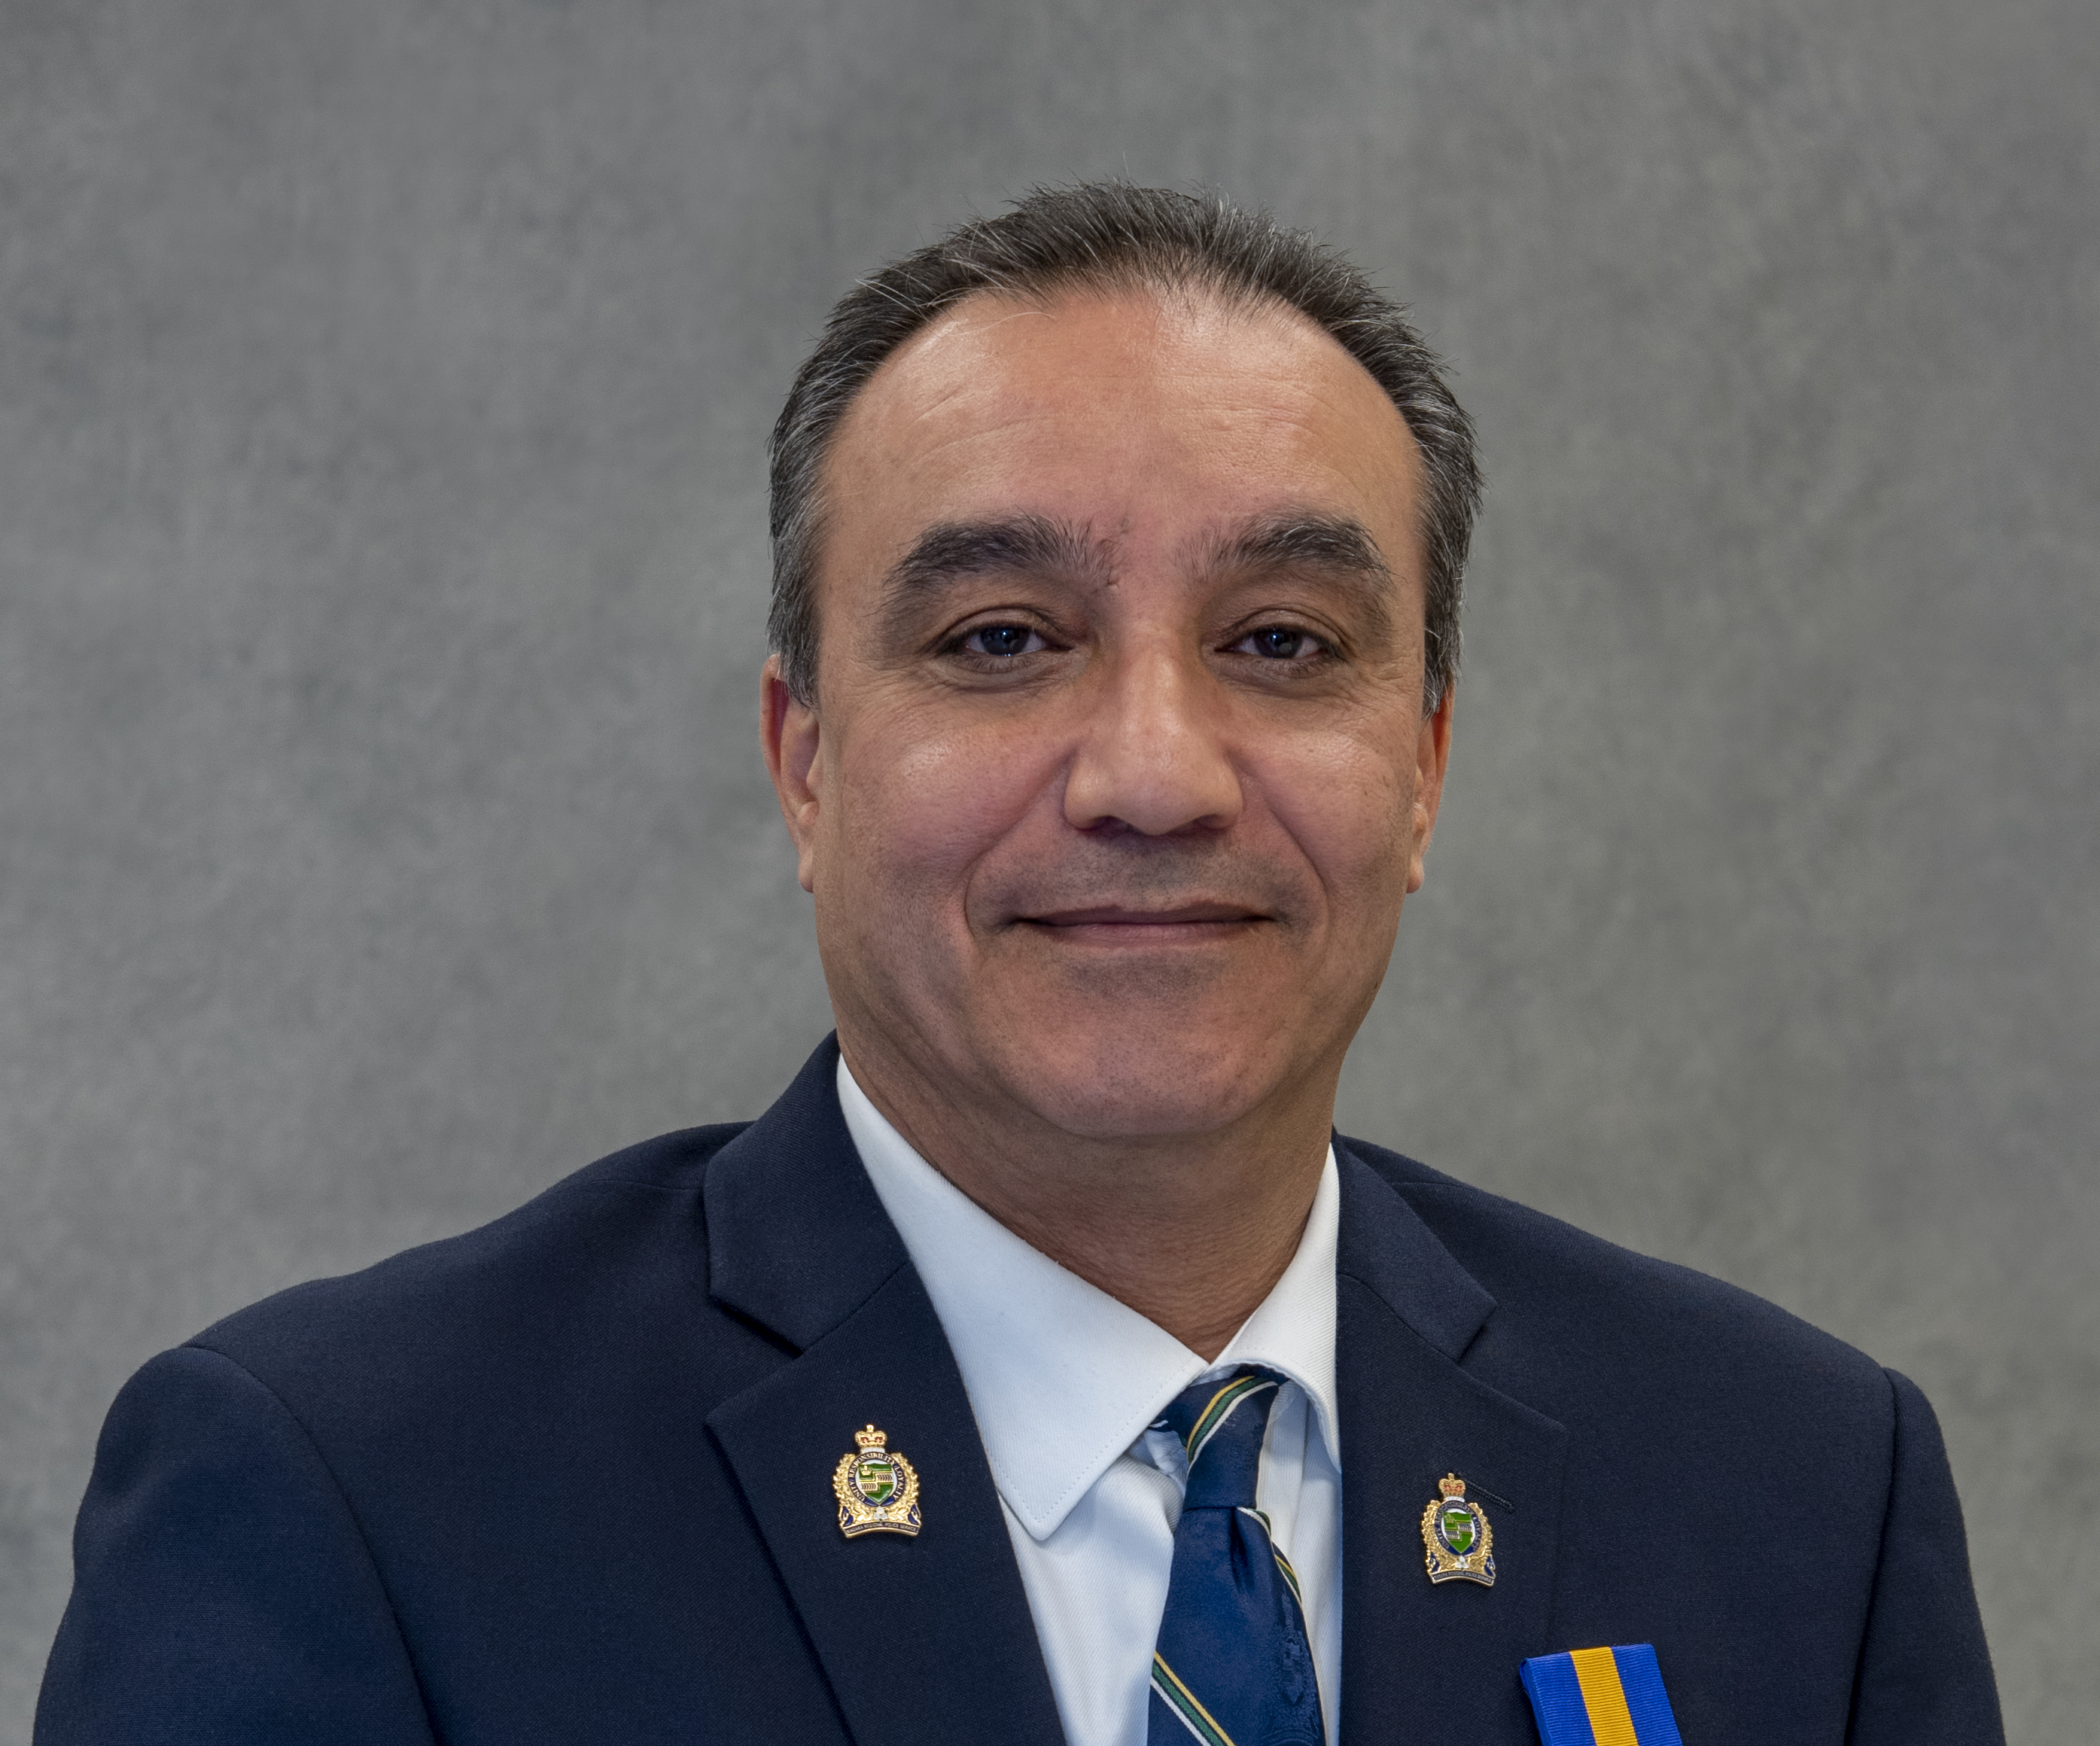
Kevin Kortekaas
Talia Storm
Jessica Potts
Carolyn Mullin
Akram Askoul
Notes:
Welcome to our Leadership Niagara Alumni Panel - Katie McQuestion to introduce and to thank.

Slide 7

Break
5 minutes
Notes:
5 to 10 minute break

Slide 8
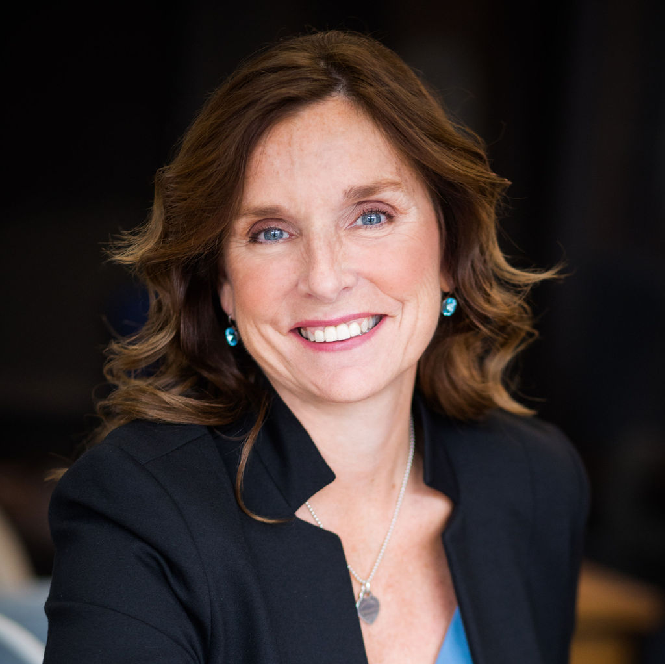
Holly Catalfamo
Senior Director of Global Engagement, Niagara College
Notes:
Carrie to introduce and to thank

Slide 9

This Photo by Unknown Author is licensed under CC BY
Notes:
Terry to provide any details regarding allergens etc.

Slide 10

Desert Island
This Photo by Unknown Author is licensed under CC BY-NC-ND
Notes:
Explain the desert island activity. - Carrie

Slide 11

Shane Malcolm
Tetramaps
Notes:
Carrie to introduce Shane using Bio in Teams – and to thank

Slide 12
Break
5 minutes
Notes:
5 to 10 minute break

Slide 13



What is something I heard today that squares with my beliefs?
What thoughts are circling around in my head?
What are three points that I want to remember from today?
Notes:
Maybe Katie – or Ann
Reminder that they have a page about reflections in their portfolio and can journal this anyway that they wish – we hope they keep these reflections in a notebook or on paper in their padfolio.

Slide 14
Recap of our Opening Retreat and Day One
Through the course of the Opening Retreat and Day One you were introduced to the:
Leadership Niagara program, its history and its competency focus
Kouzes and Posner 5 practices of Exemplary Leadership
Tetramap assessments
You have identified some goals for your personal leadership journey and have had the opportunity to reflect on your personal leadership attributes.
We hope you have reflected on where you are in your leadership journey so far and are excited to continue this journey with us.

Slide 15

Day One Reflection:
Between now and next session, watch how you and the leaders with whom you interact display the 5 Practices from K and P or any of the LN Leadership Competencies.

Slide 16
Community Projects Next Steps
A summary of each Community Project submission will be posted on the website
Please be sure to review these summaries carefully
You may want to research the community group
Remember – this is an opportunity for growth
Project leaders will be present on Day Two
By the end of Day Two you will have ranked your top three choices
You may not get your first choice
Notes:
Carrie or Ann to review this process – be sure to highlight that the projects are fluid – they are meant to have you stretch your skills not reinforce your current skills. They are completed on your own time although we provide touchpoints on our learning days and you can always meet over lunch or at the end of a learning day.

Slide 17
Next Steps for Learning Day Two
You will receive a survey within the next week via Survey Monkey
  Check your spam filters if you don’t see it!
Day Two will take place at Club Capri in Thorold, November 22, 9 am to 4:30 pm
  Information about the Day will be uploaded to the website under Participants
Notes:
Terry to provide next steps as well as feedback process for learning day one.

Slide 18

Please join us across the street at…..

