Slide 1

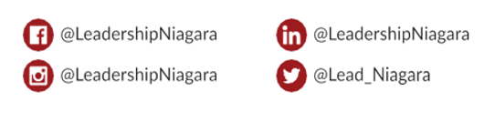

WELCOME TO #CLDP2425
In Partnership With
Visionary Sponsor
Follow & Tag

Slide 2

Land Acknowledgement
I would like to begin by acknowledging that the land on which we gather today has been the traditional territory of indigenous peoples for countless generations; most recently by the Anishinaabeg and Haudenosaunee Peoples through the Dish with One Spoon Wampum Belt, an agreement to peaceably share and care for the resources around the Great Lakes.
This wampum predates Treaty 3 of the Upper Canada Treaties, highlighting the tremendous contribution these nations have made to our shared history Today we would like to acknowledge these contributions and how thankful we are, that today, we are able to share this land with them.

Slide 3
Kick Off Breakfast Agenda
Land Acknowledgement
Welcome from Nour Hage, Chair, Leadership Niagara
Welcome from Terry Dow, Executive Director, Leadership Niagara
Welcome from the Chair of the Program Advisory Committee, Ann Harrison
Employer and Participants Expectations – PAC Members
LN Sponsor Highlights
Presentation of Scholarships

Slide 4
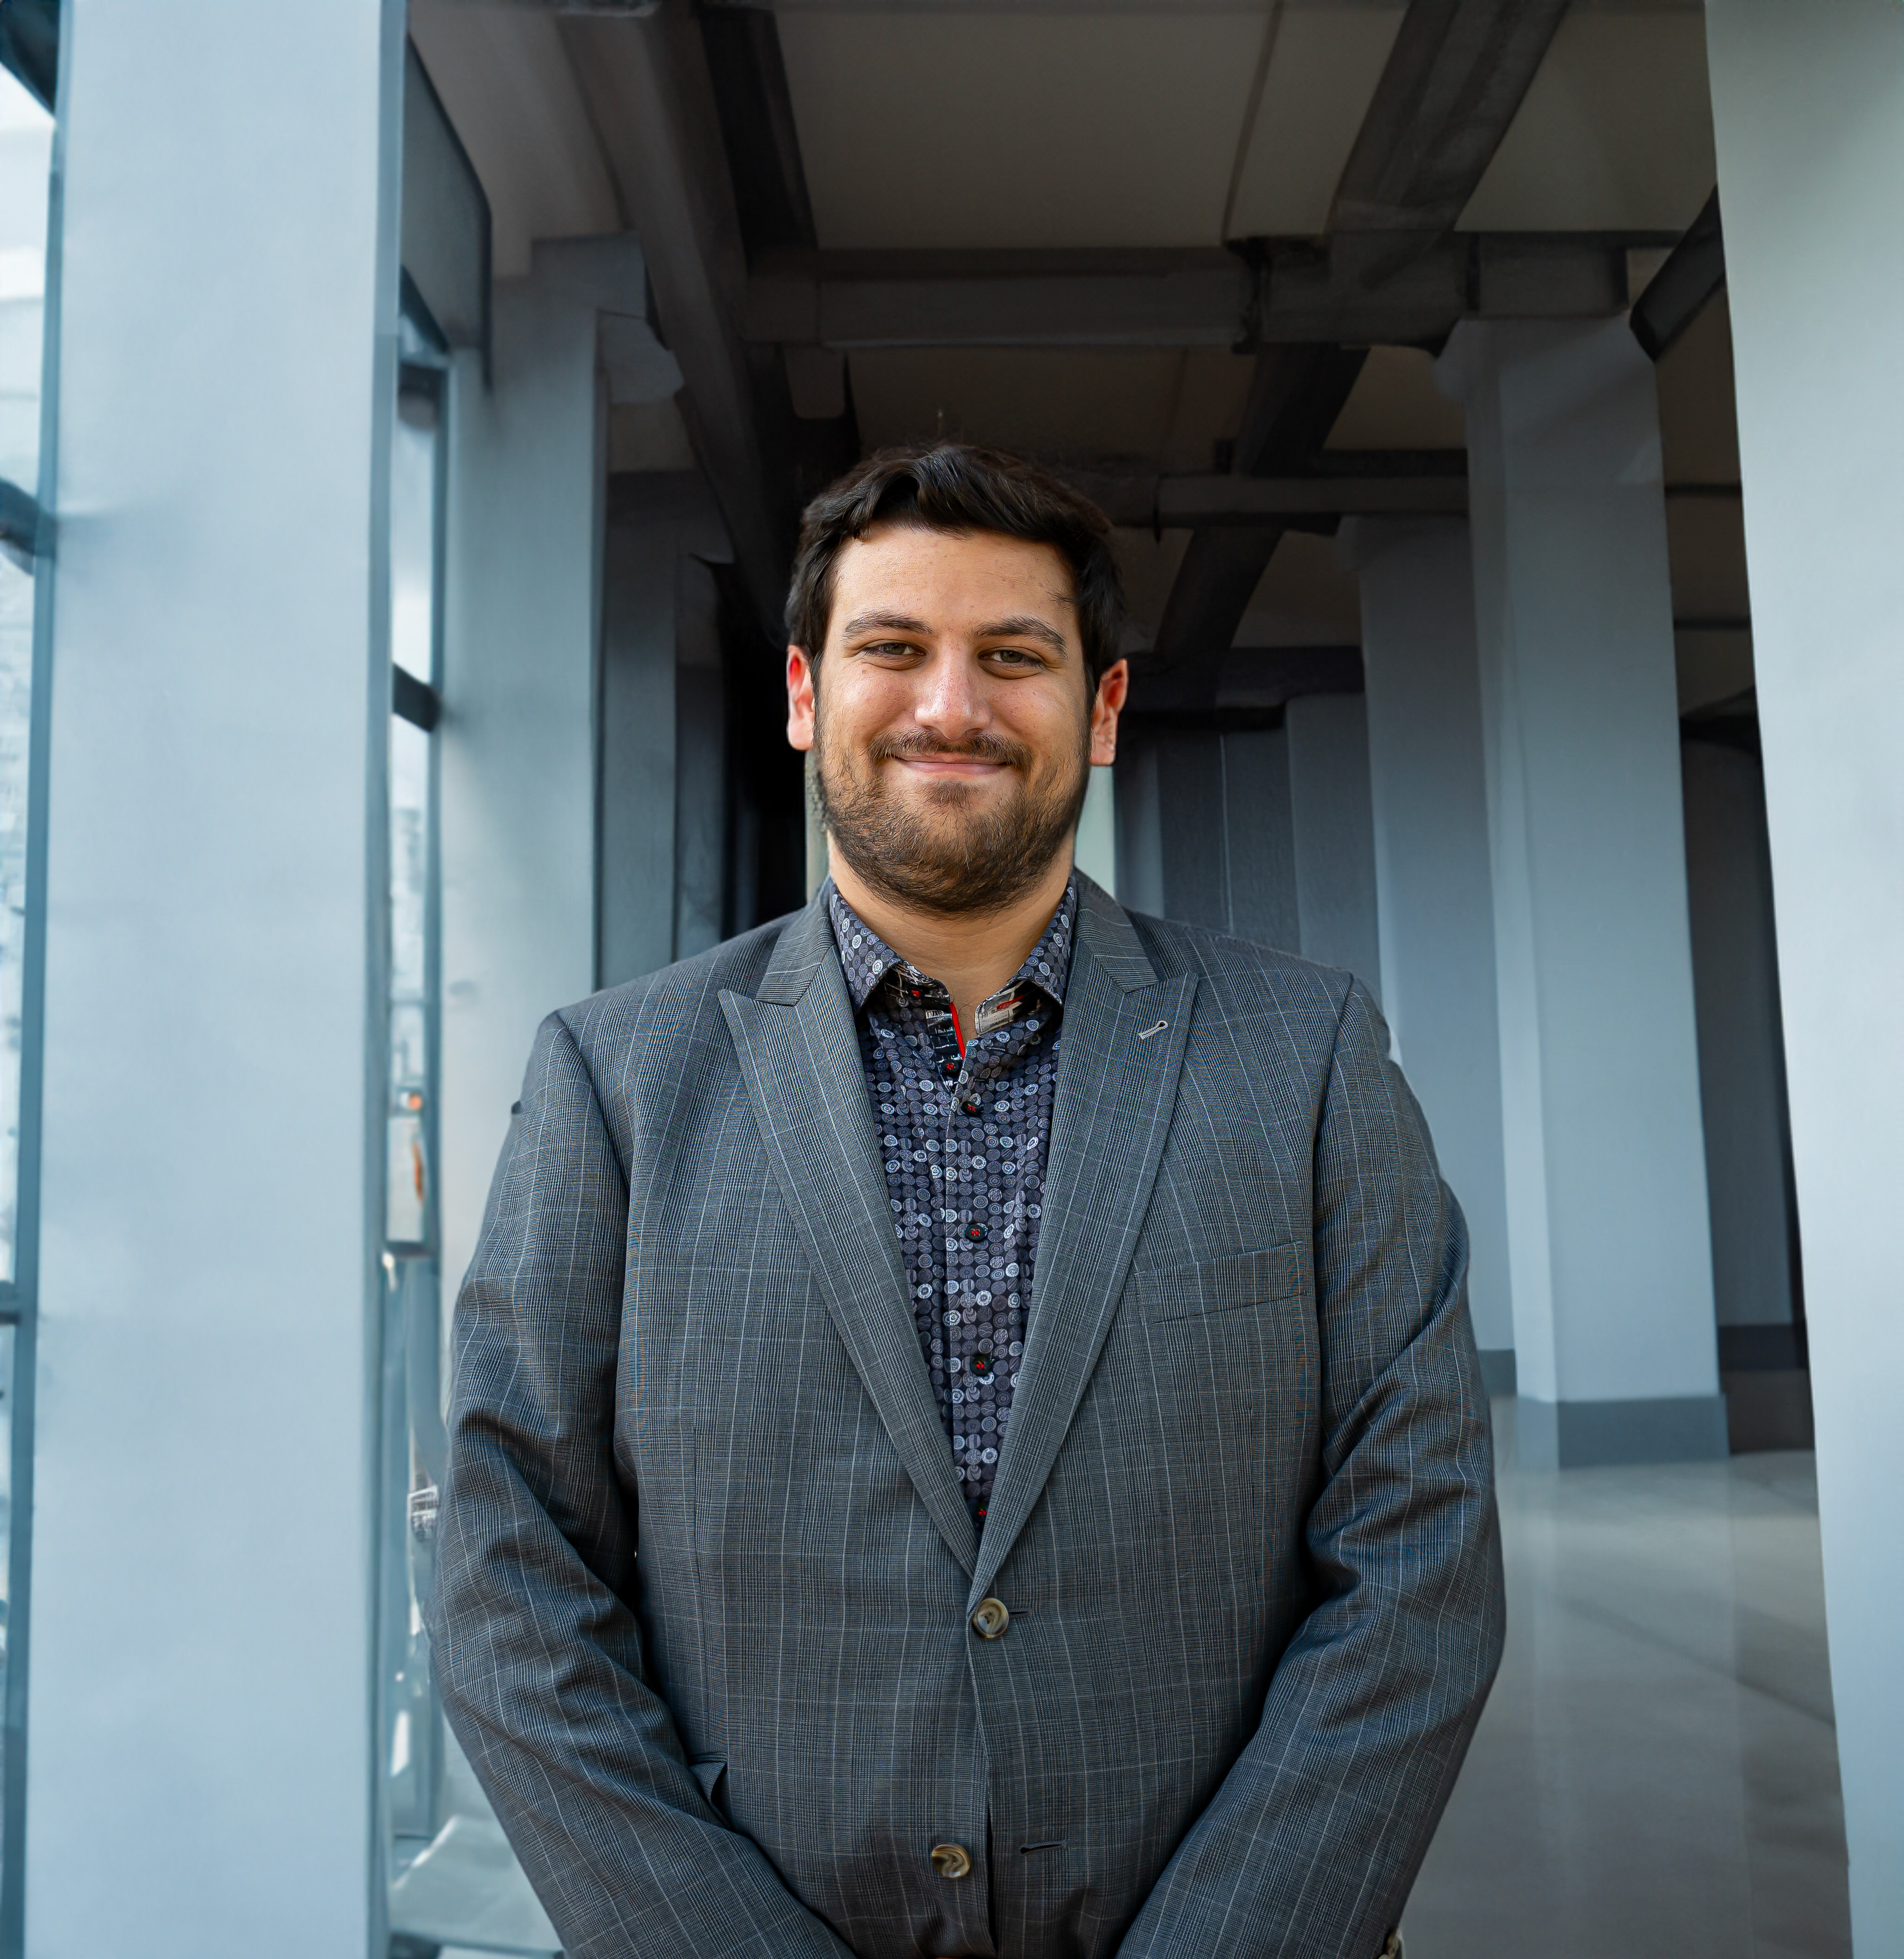
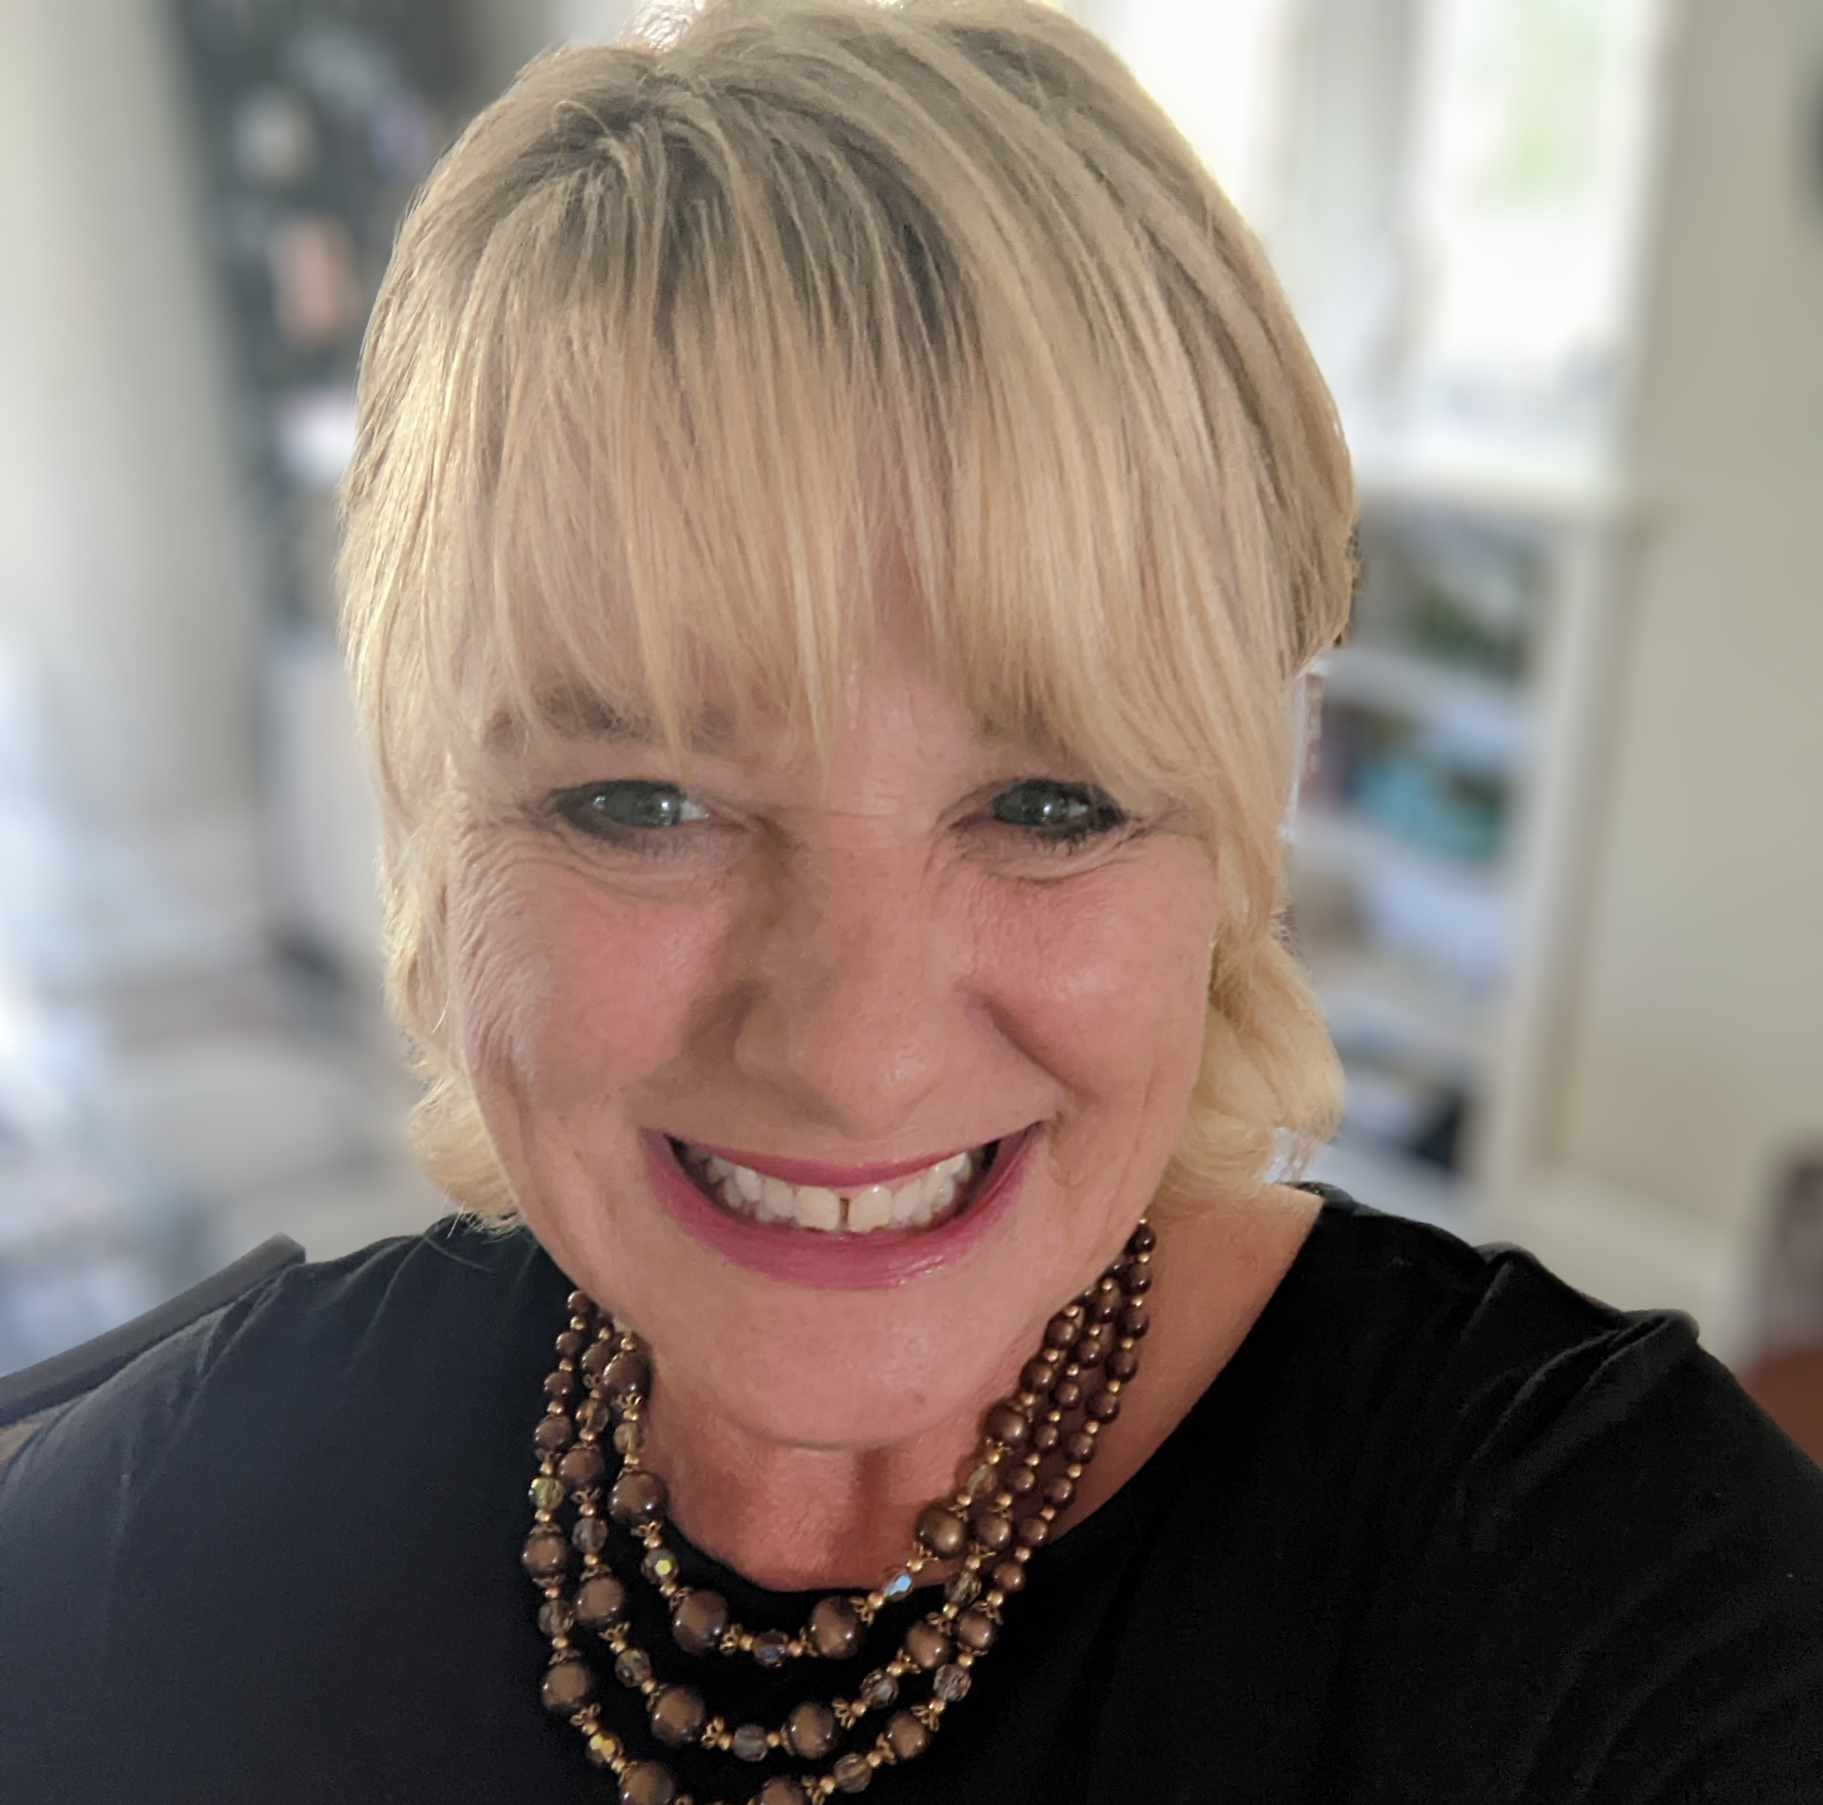
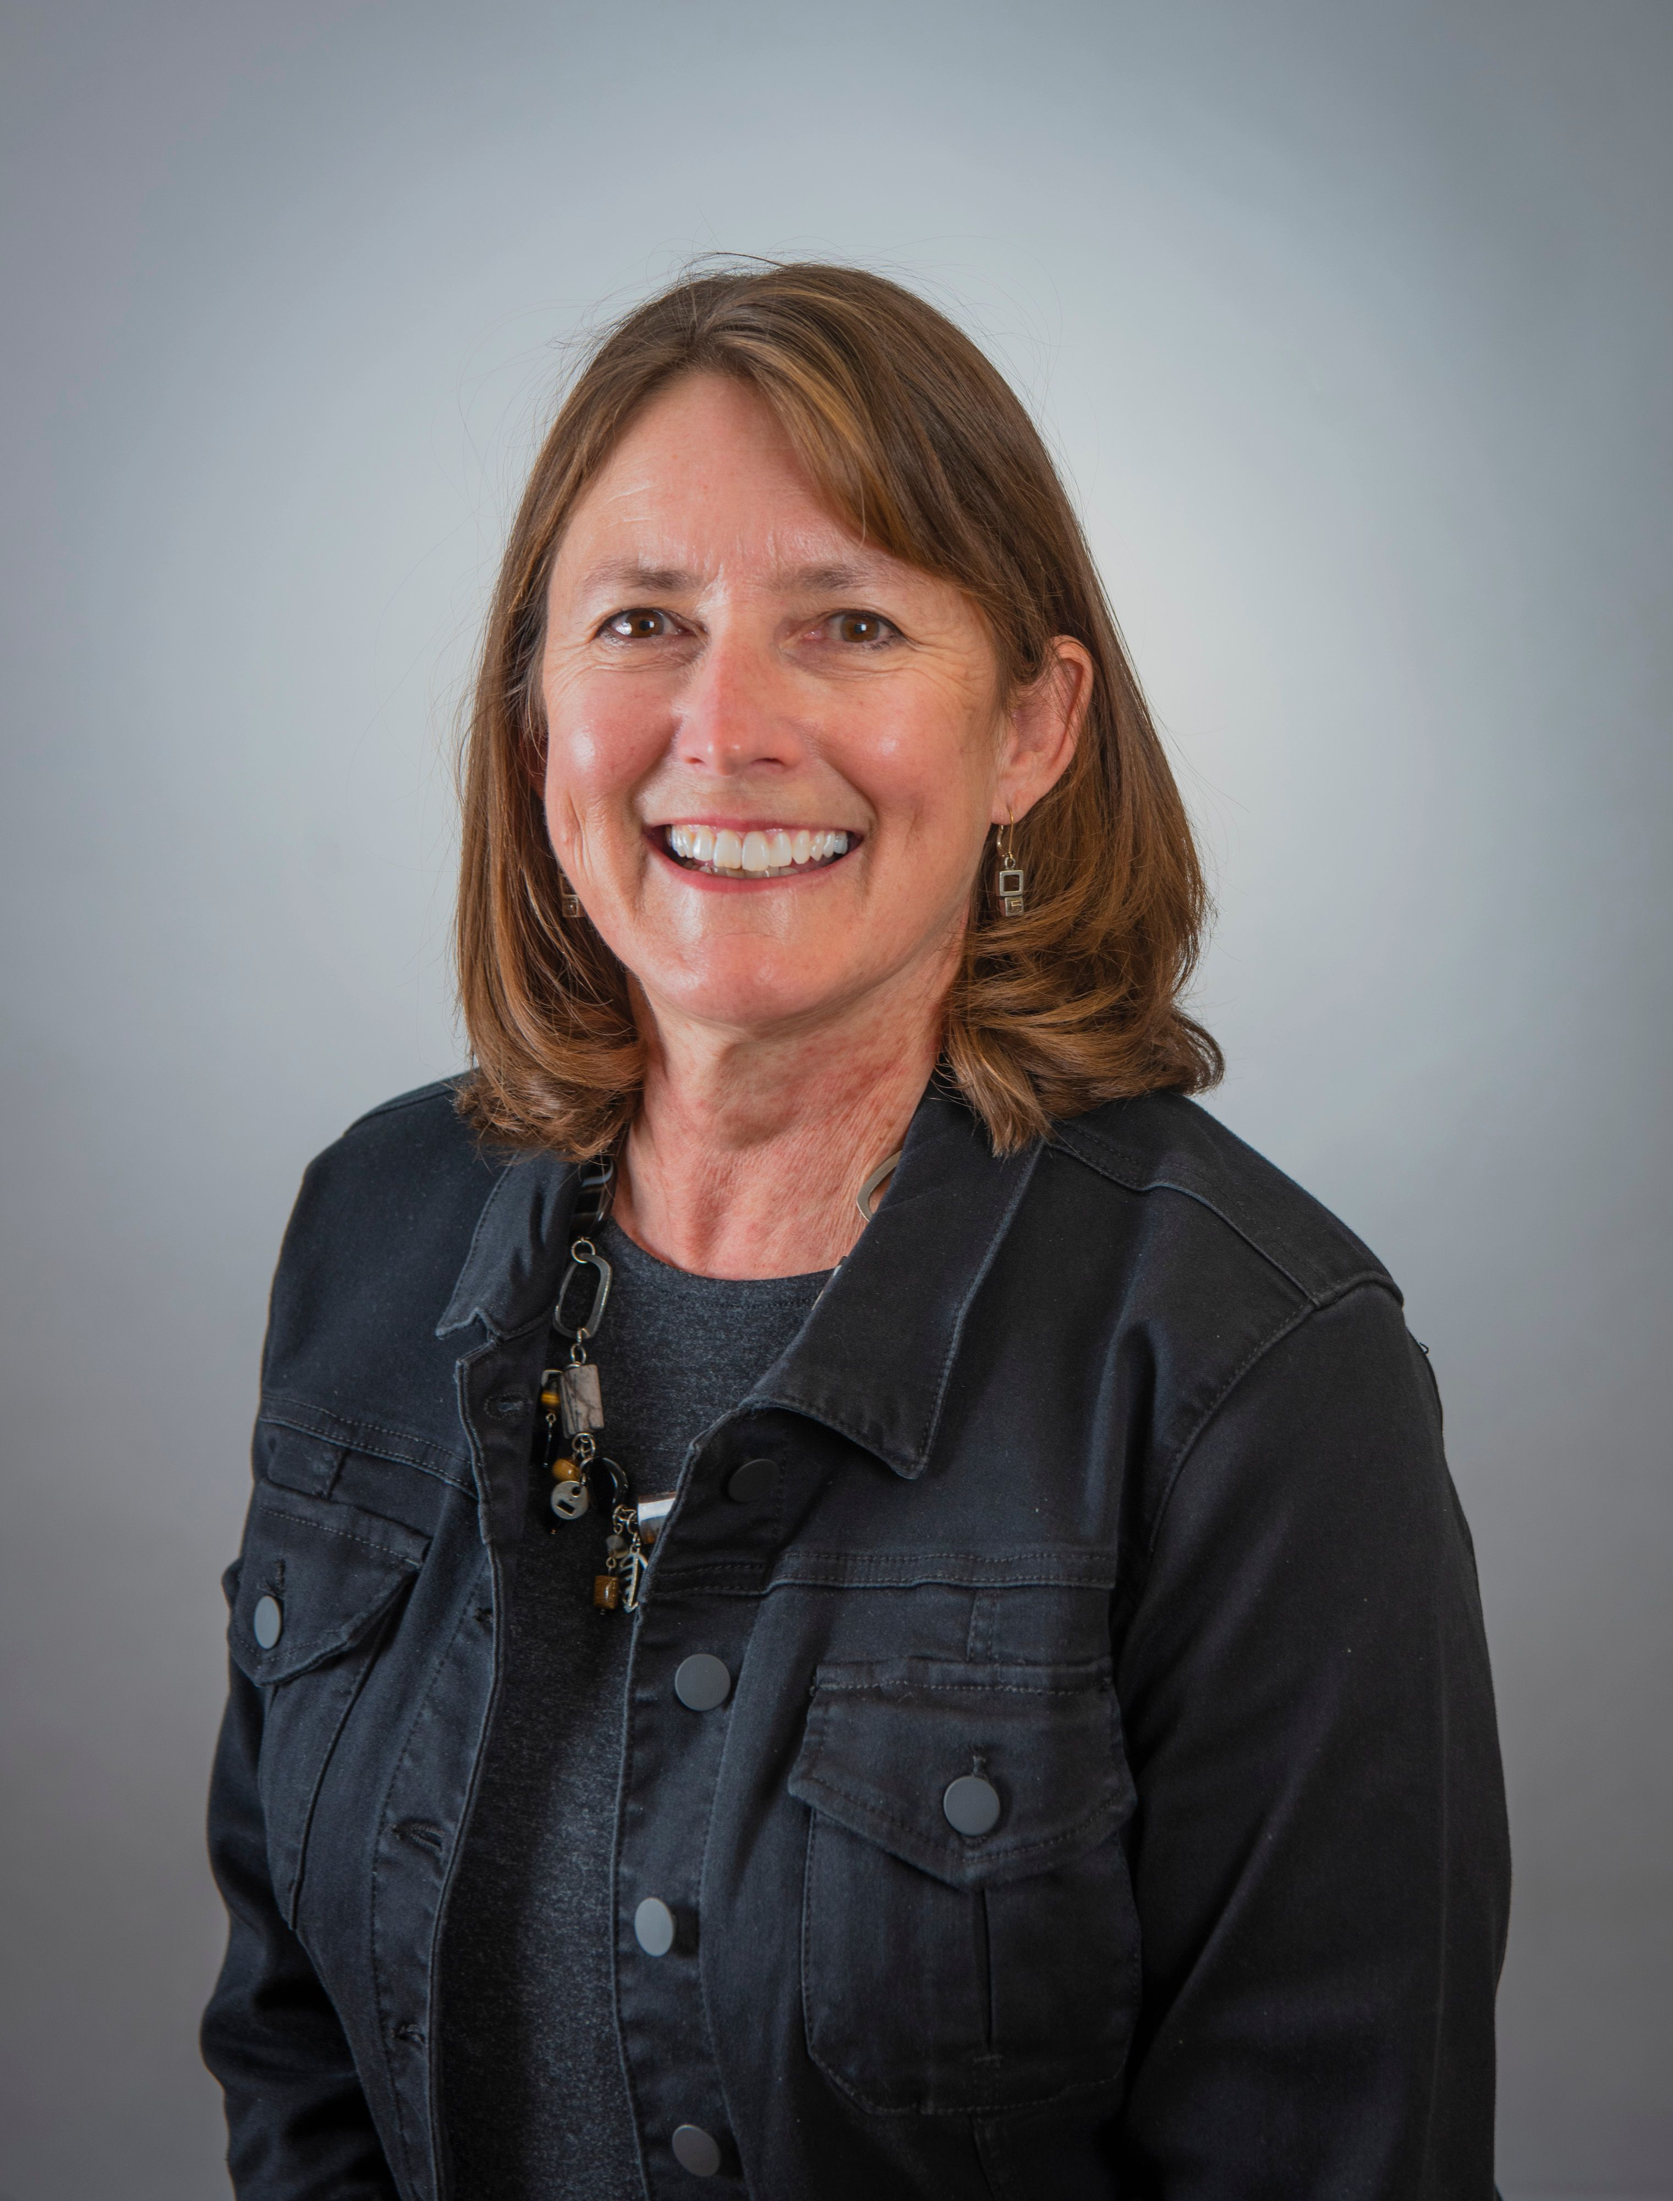

Nour Hage, Chair Leadership Niagara
Terry Dow, Executive Director
Ann Harrison, Chair Program Advisory Committee

Slide 5
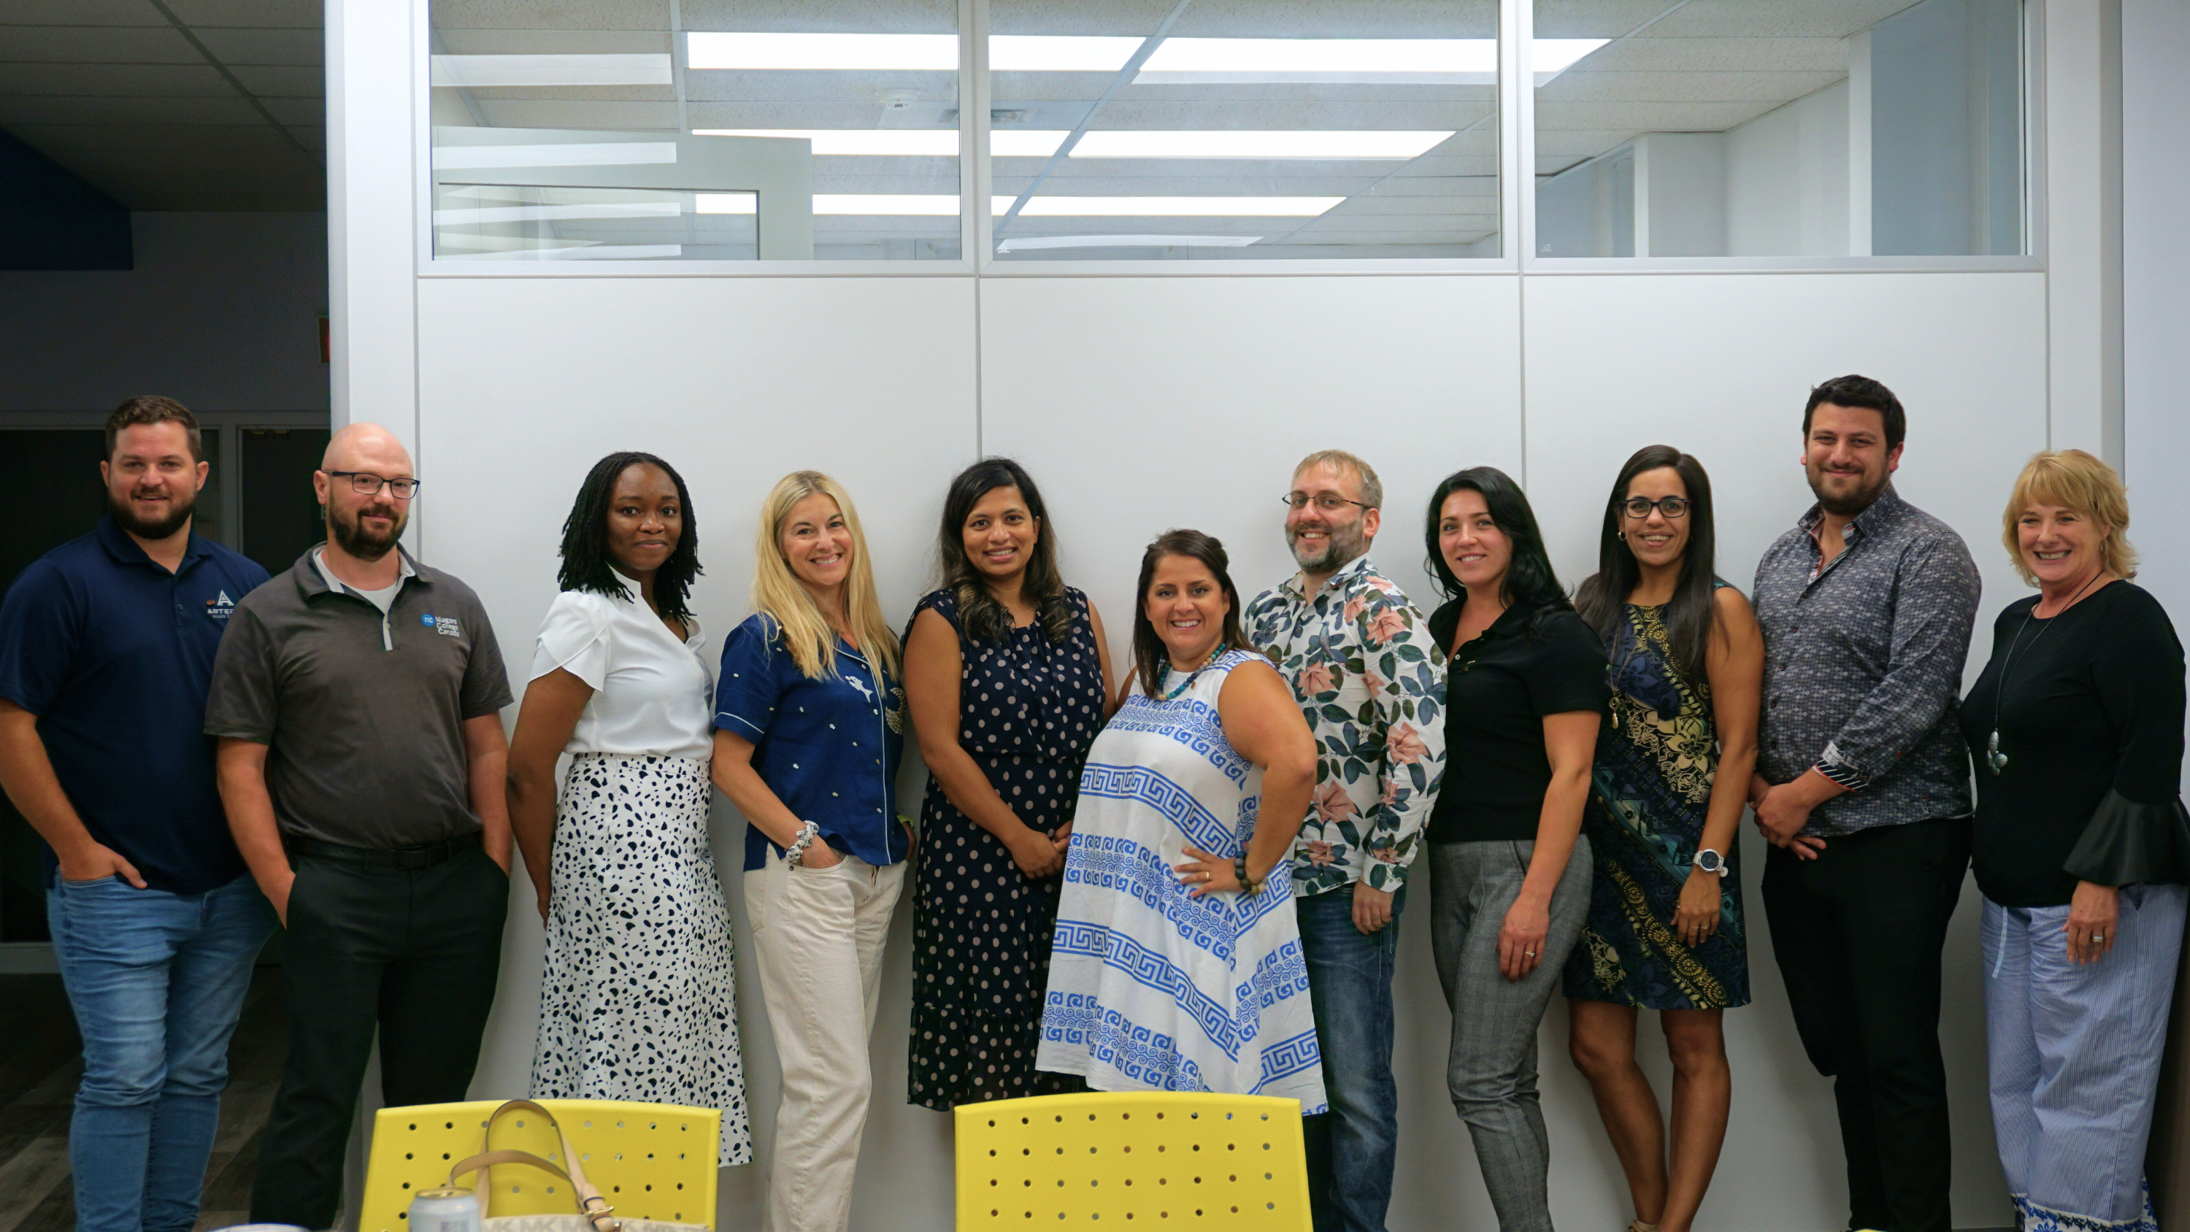
2024-25
Board Members
Dan Fowler, Dan Chalmers, Karen Ogidigben, Meredith Maxwell, Joanne Coutinho, Amanda Nicol-MacDonald, Sheldon King, Kiara Theodosopoulos, Namrata Mahboobani, Nour Hage (Chair)
Absent: Valarie Sadler

Slide 6
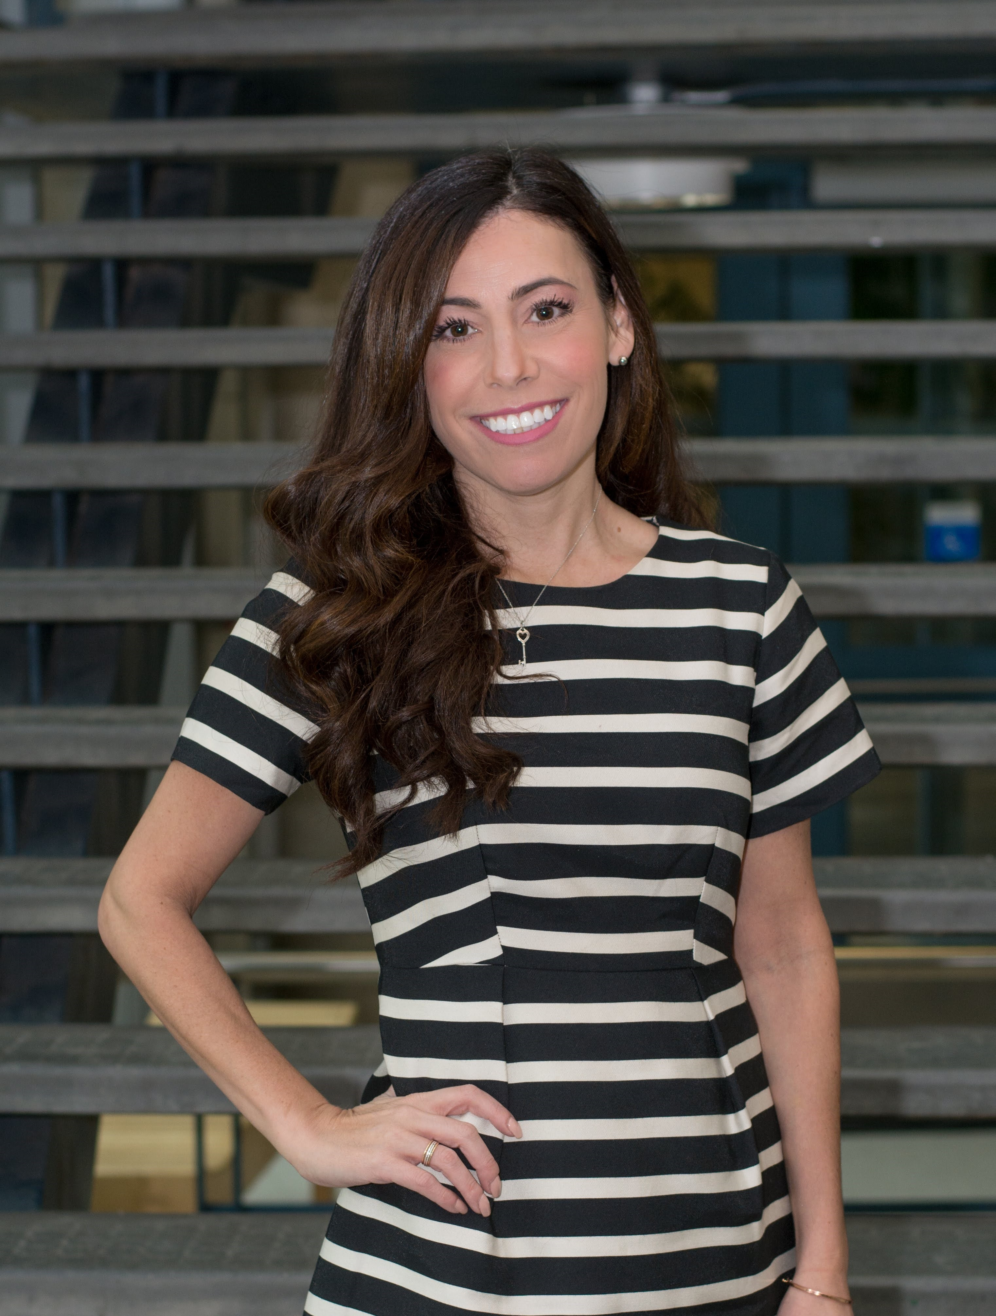
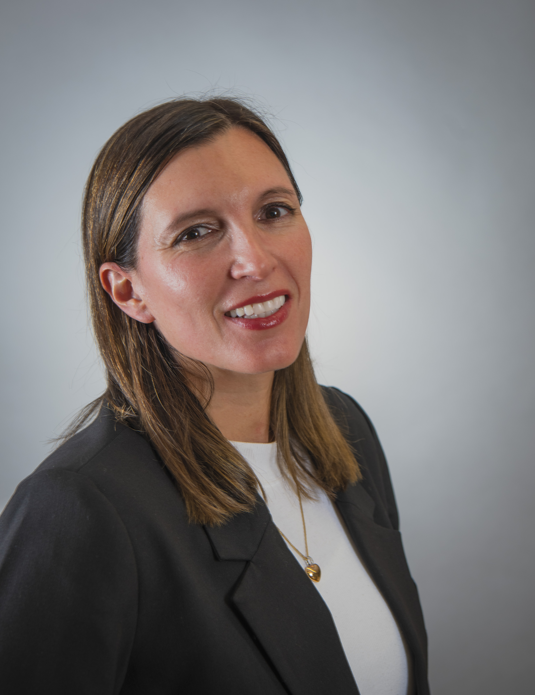
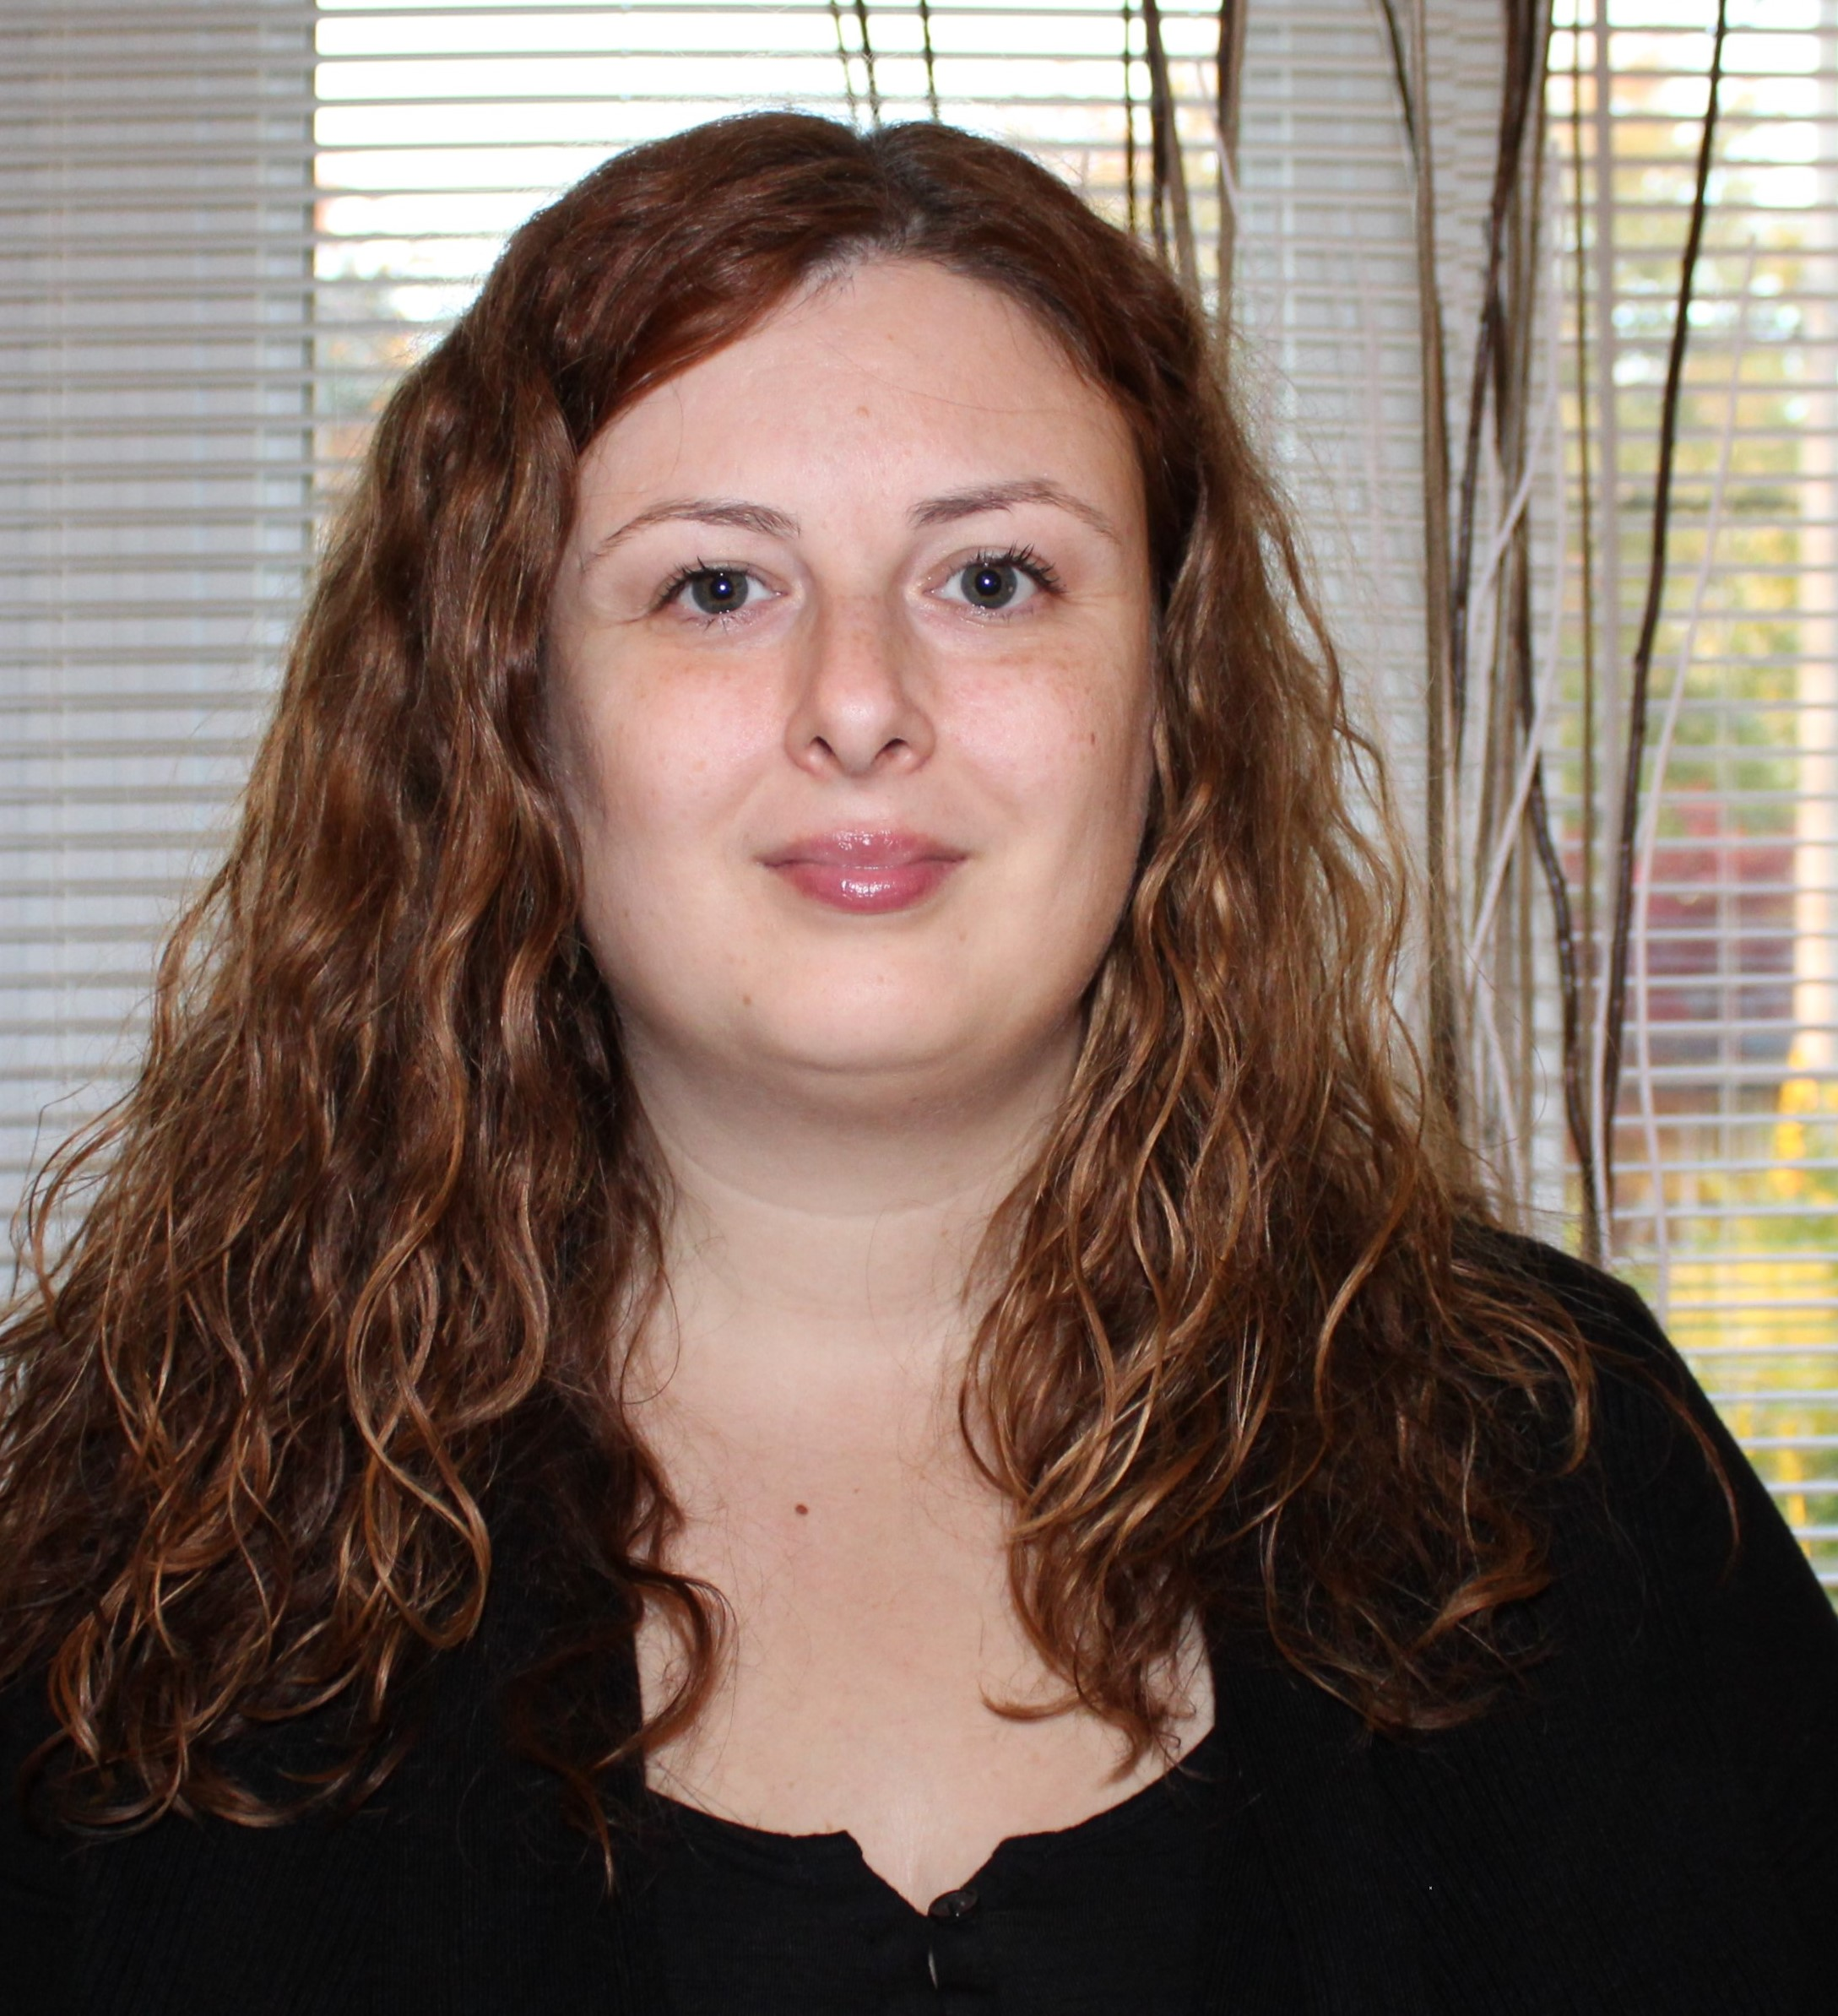
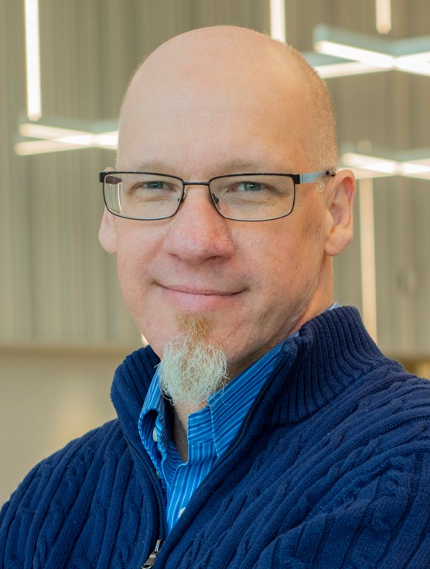
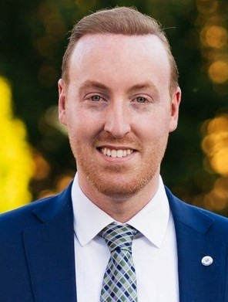
2024-25 Program Advisory Committee

Slide 7
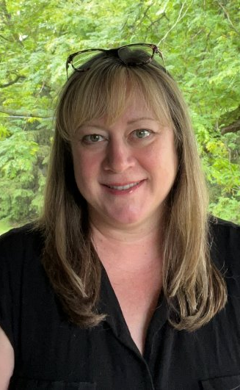
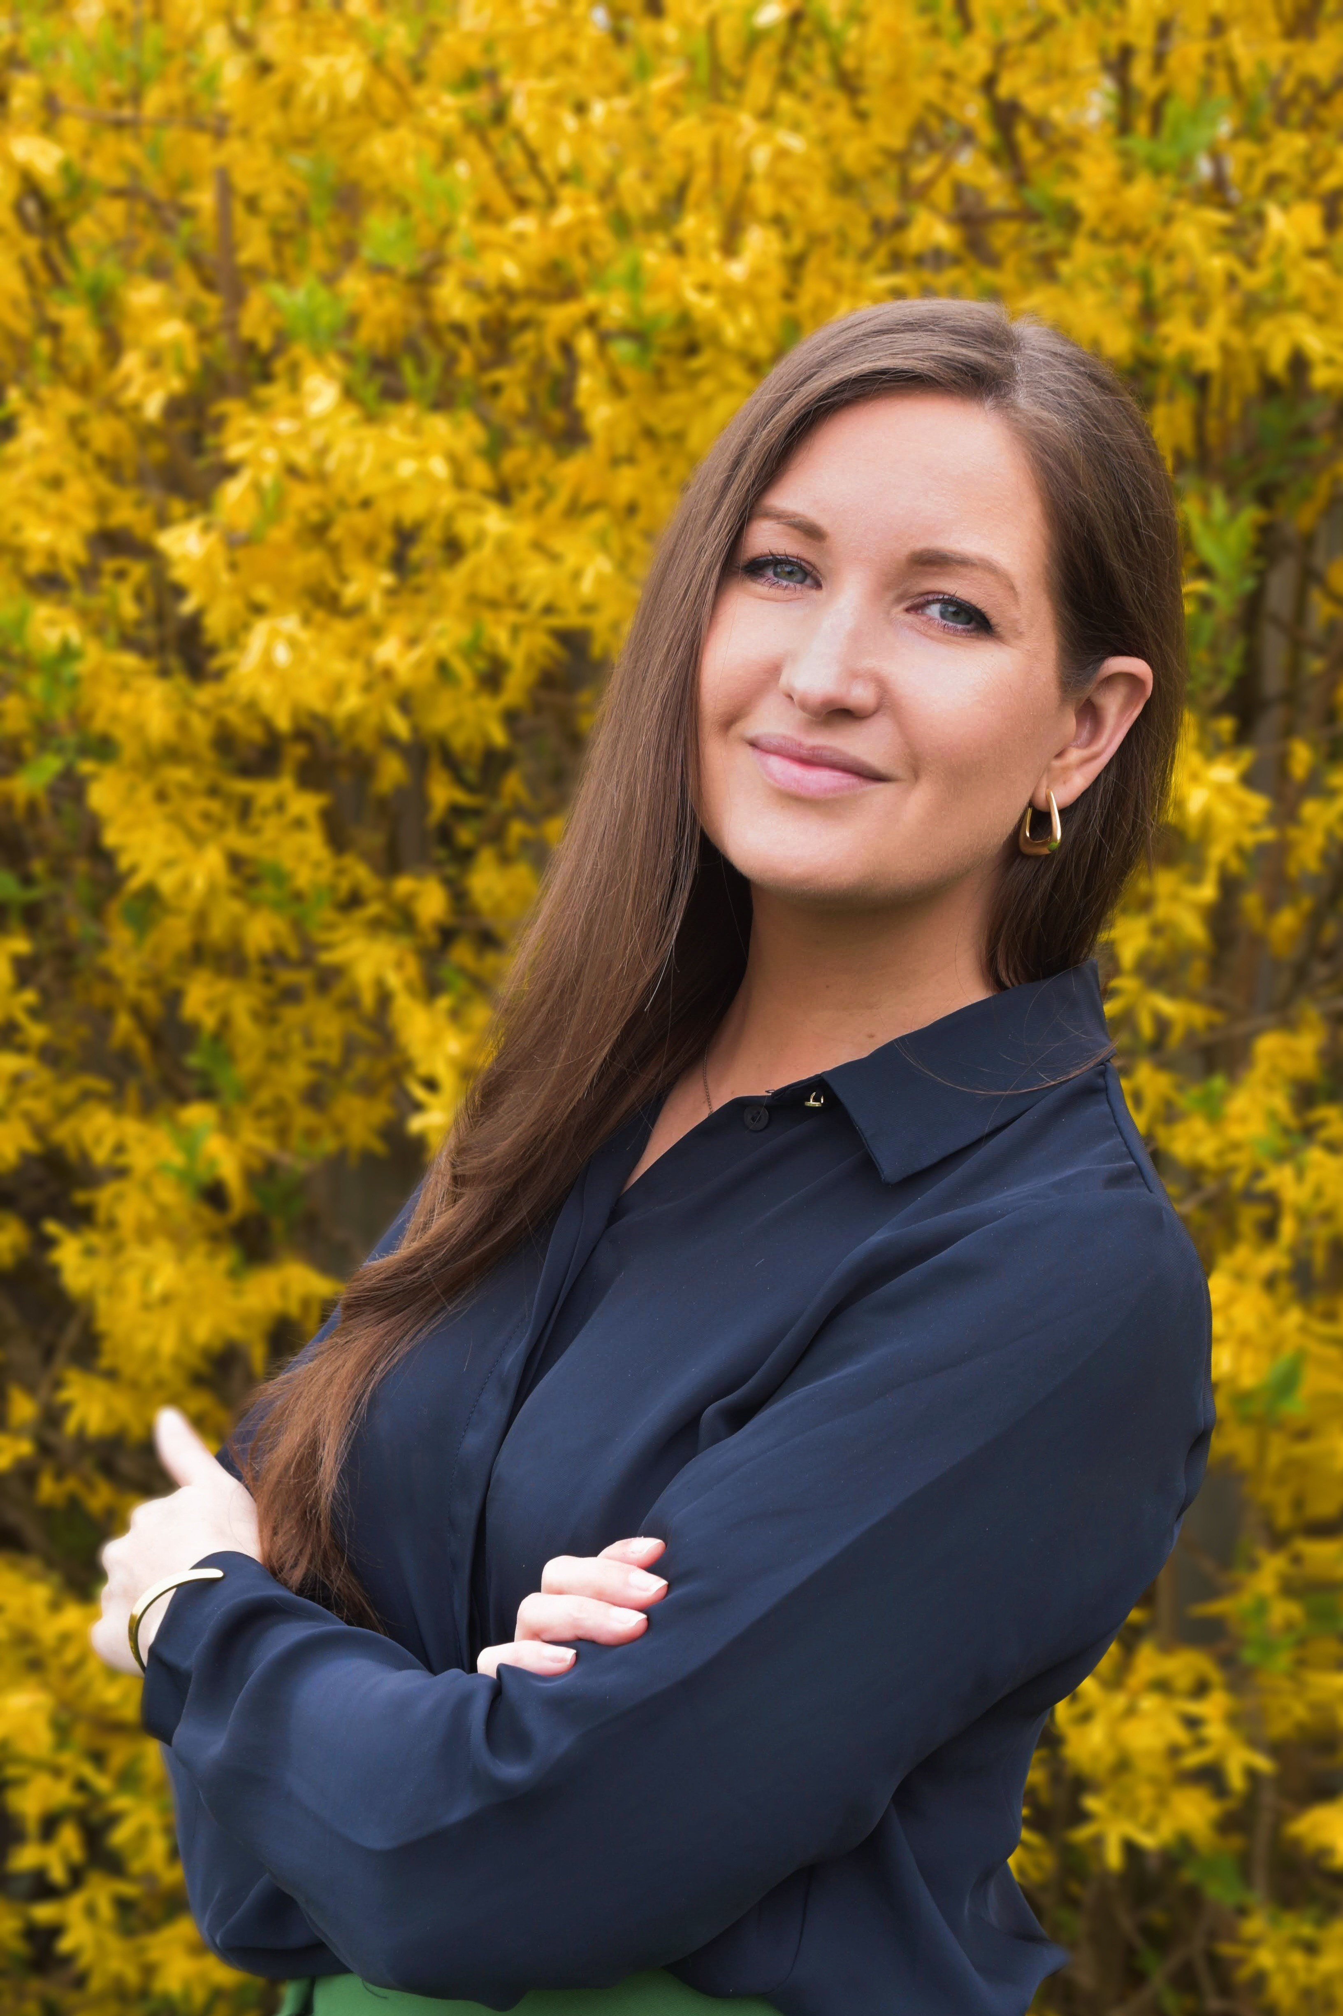
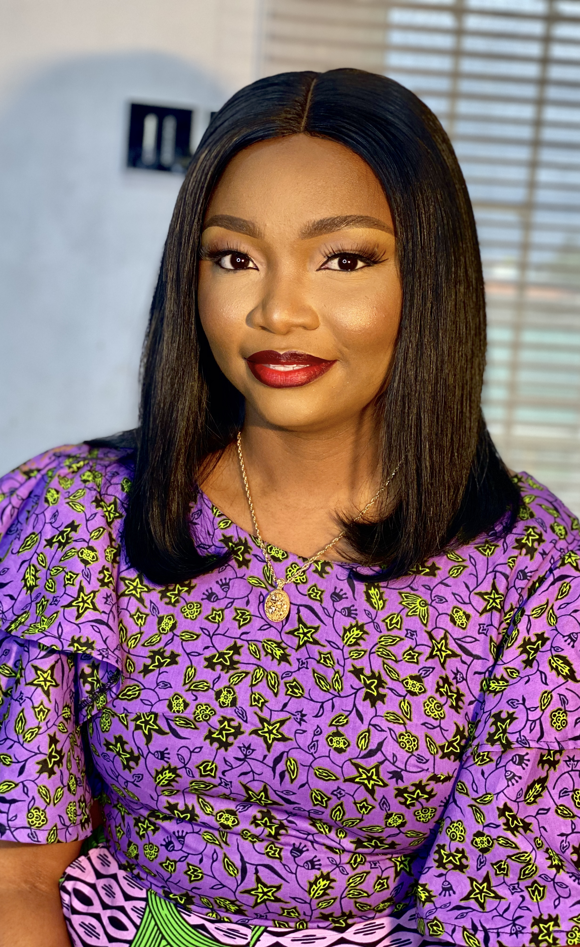
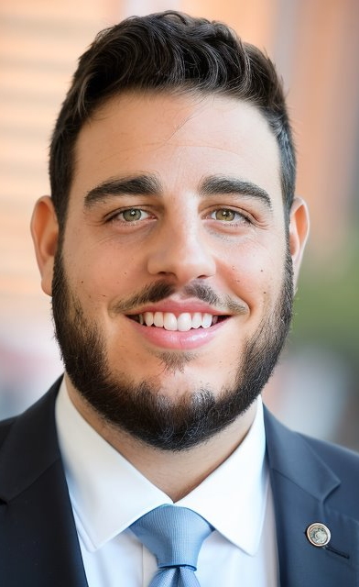
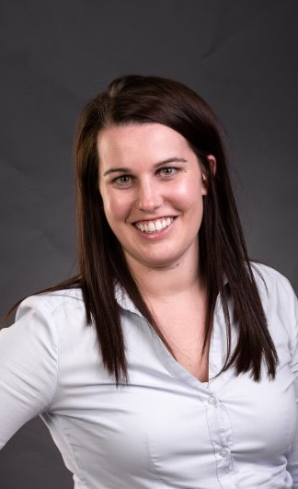
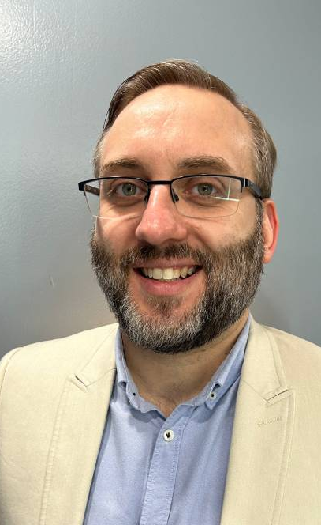
2024-25 Program Advisory Committee - continued
IT Support

Slide 8
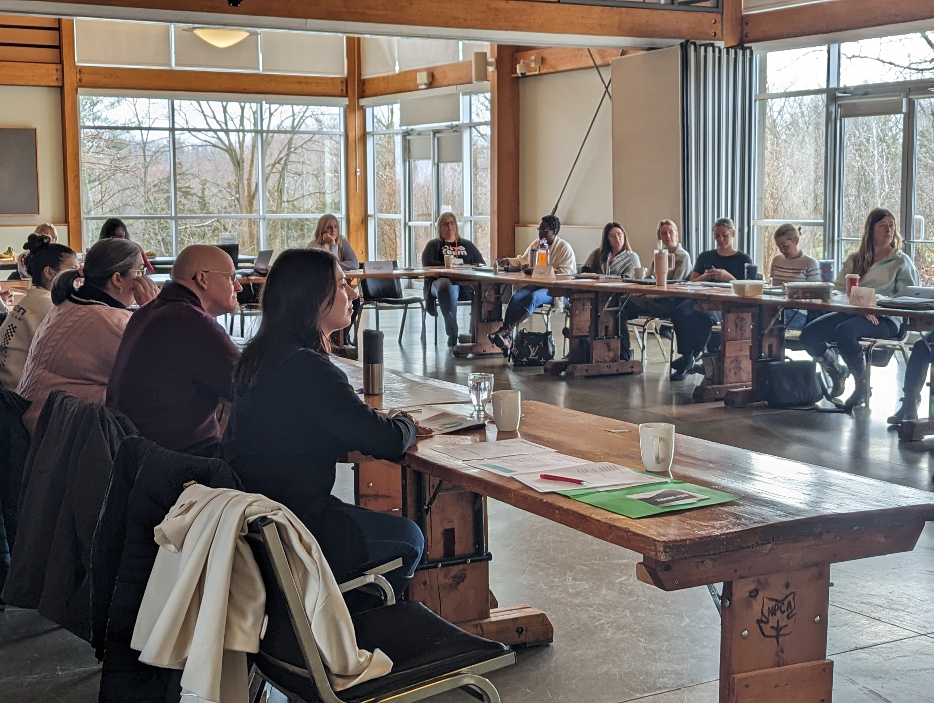
Executive Summary
Leadership Niagara Goals

Slide 9

Expectations for Employers and Participants
The success of our program stems from the support of our Employers and the active participation of our cohort. This is relies on:​
Support for attendance​
Engaged focused participation at all learning days​
Participation in additional meetings for Community Project​

Slide 10







Sponsorships
Visionary
NC Community – Niagara Casino
Niagara College
Corporate
Business Link
Associate
Niagara Association of Realtors
Community
Centre For Leading and Living
Learning Day
Walker Industries
Niagara Region
Niagara College – Research & Innovation Centre

Slide 11
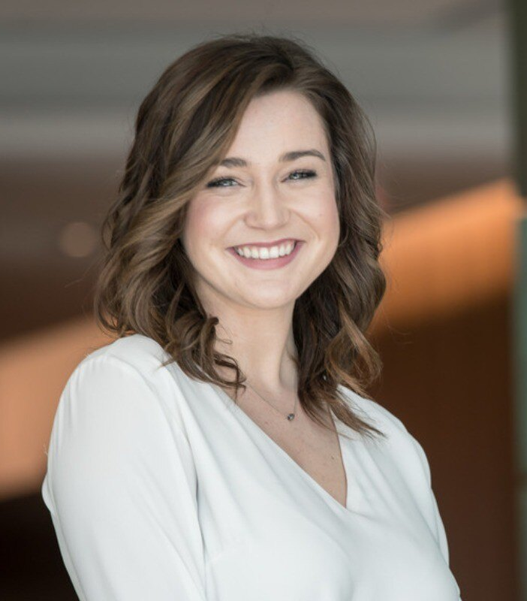
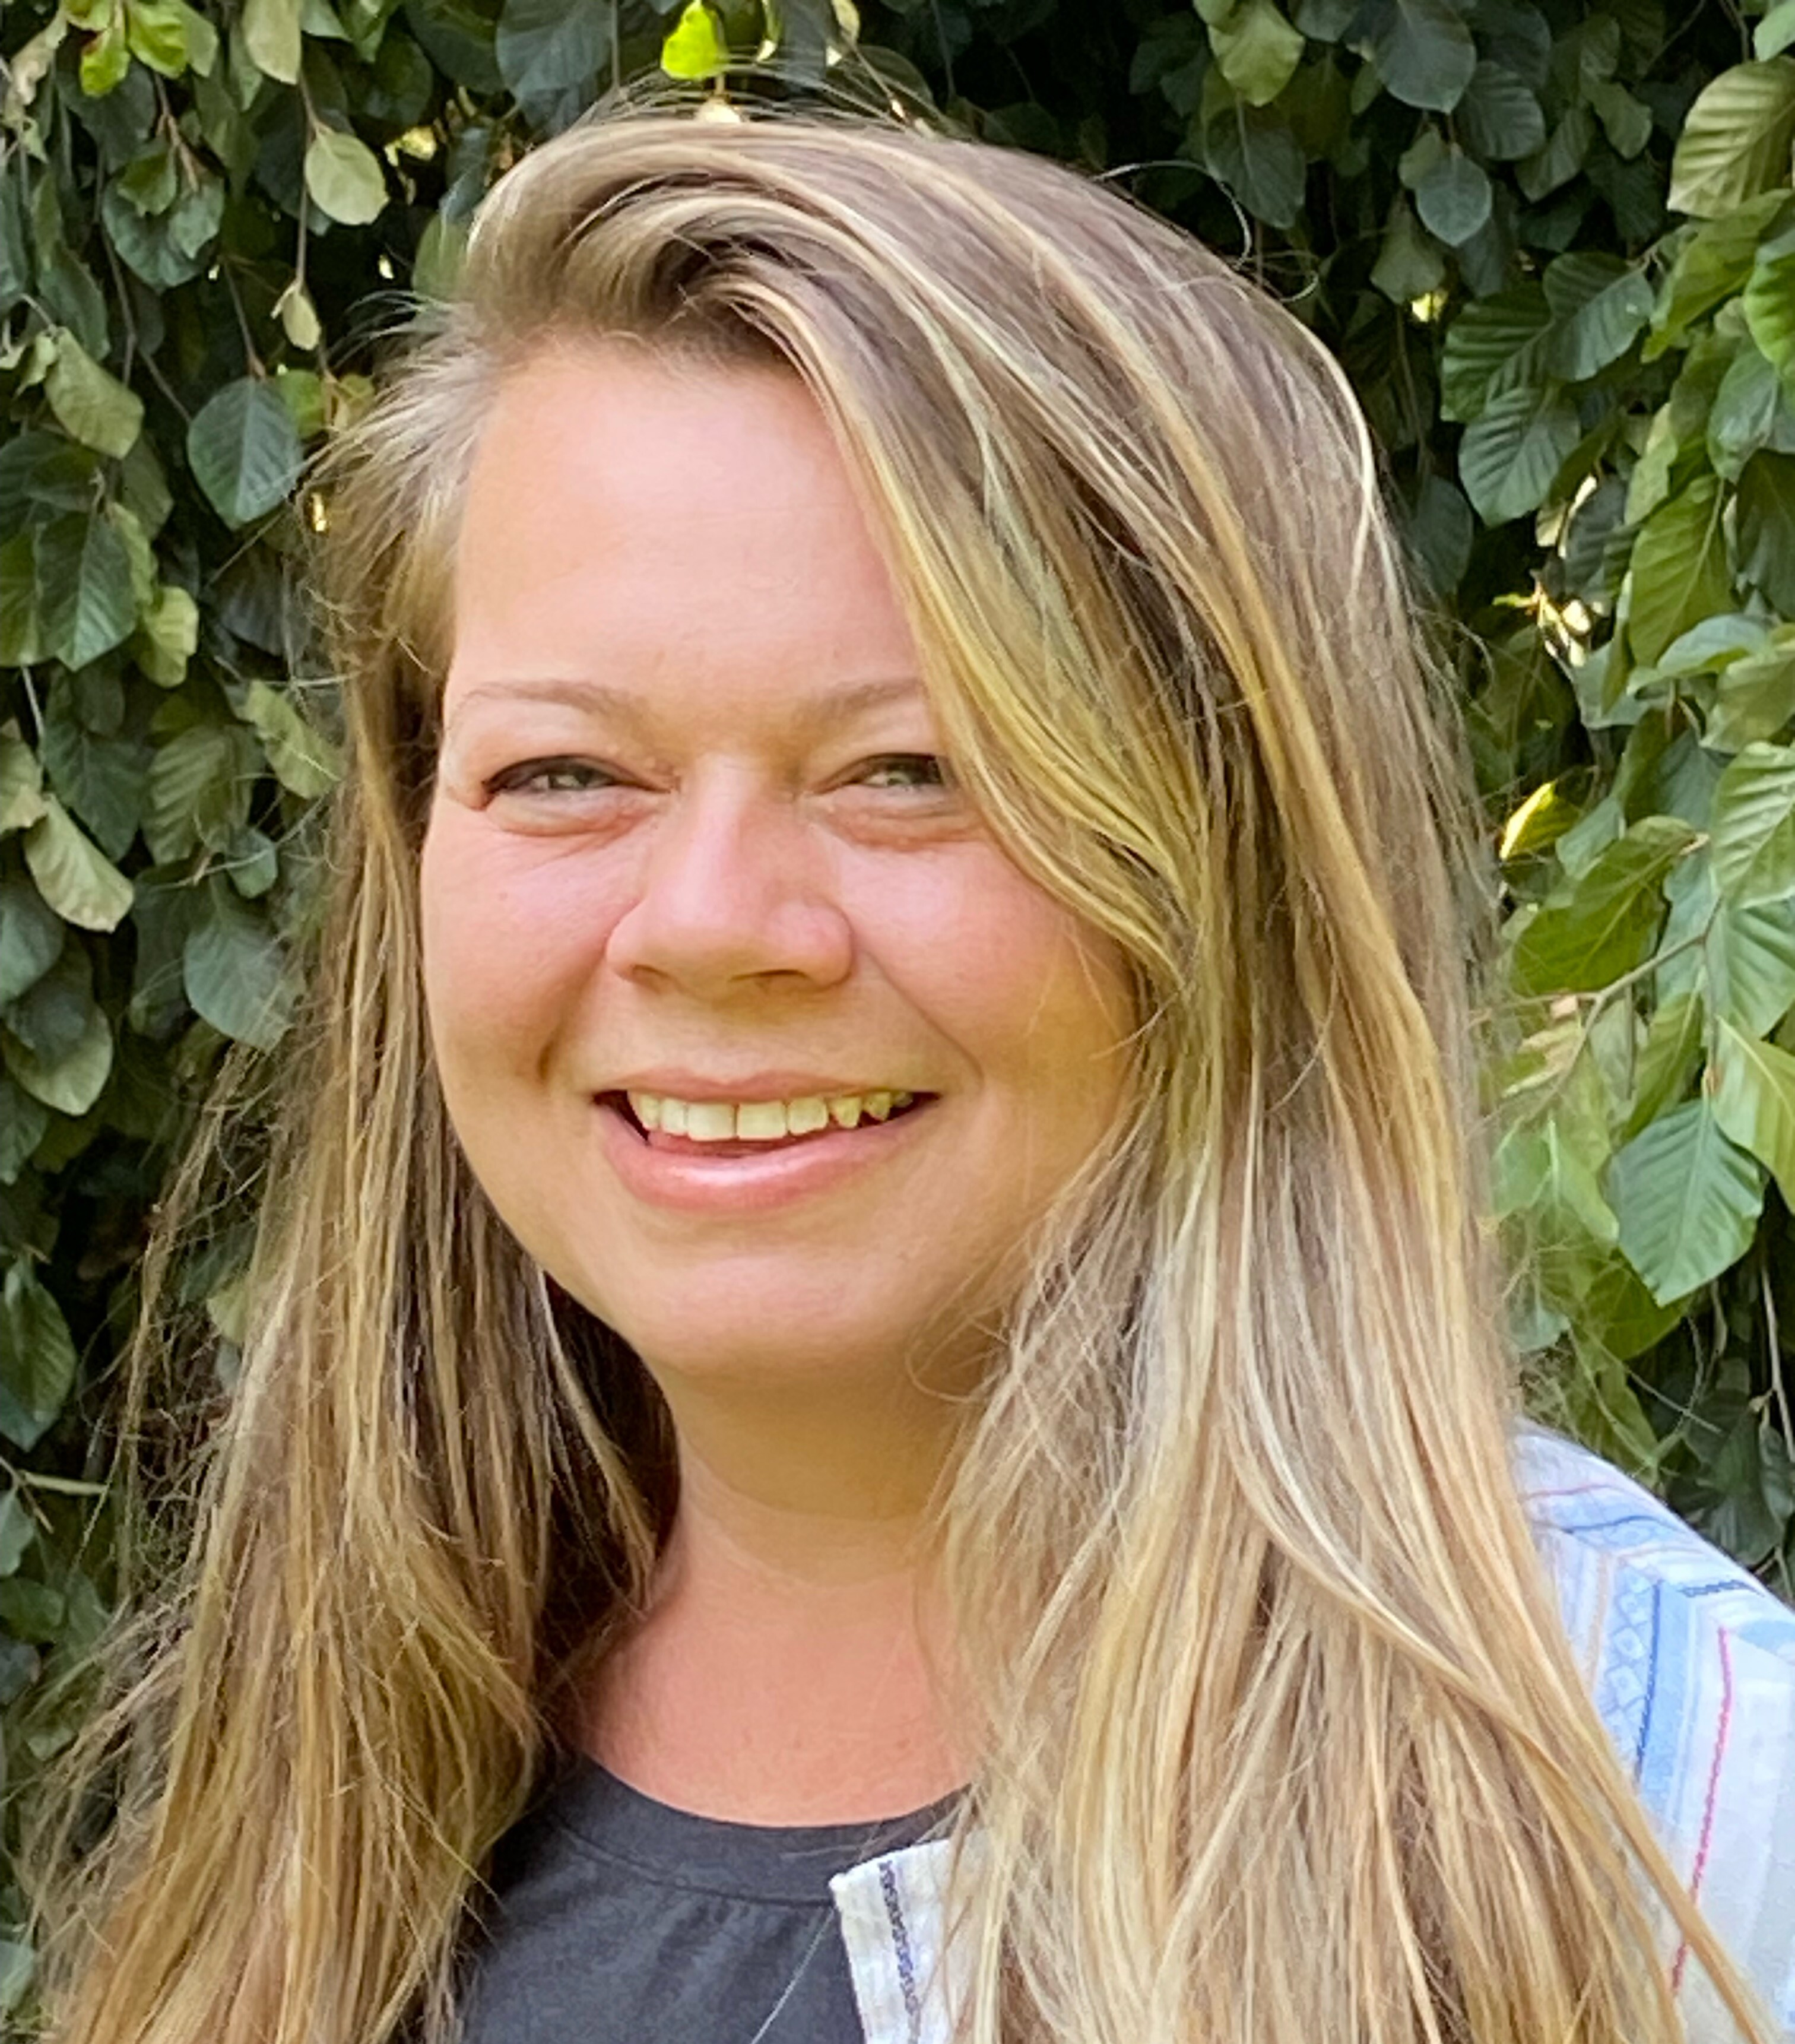
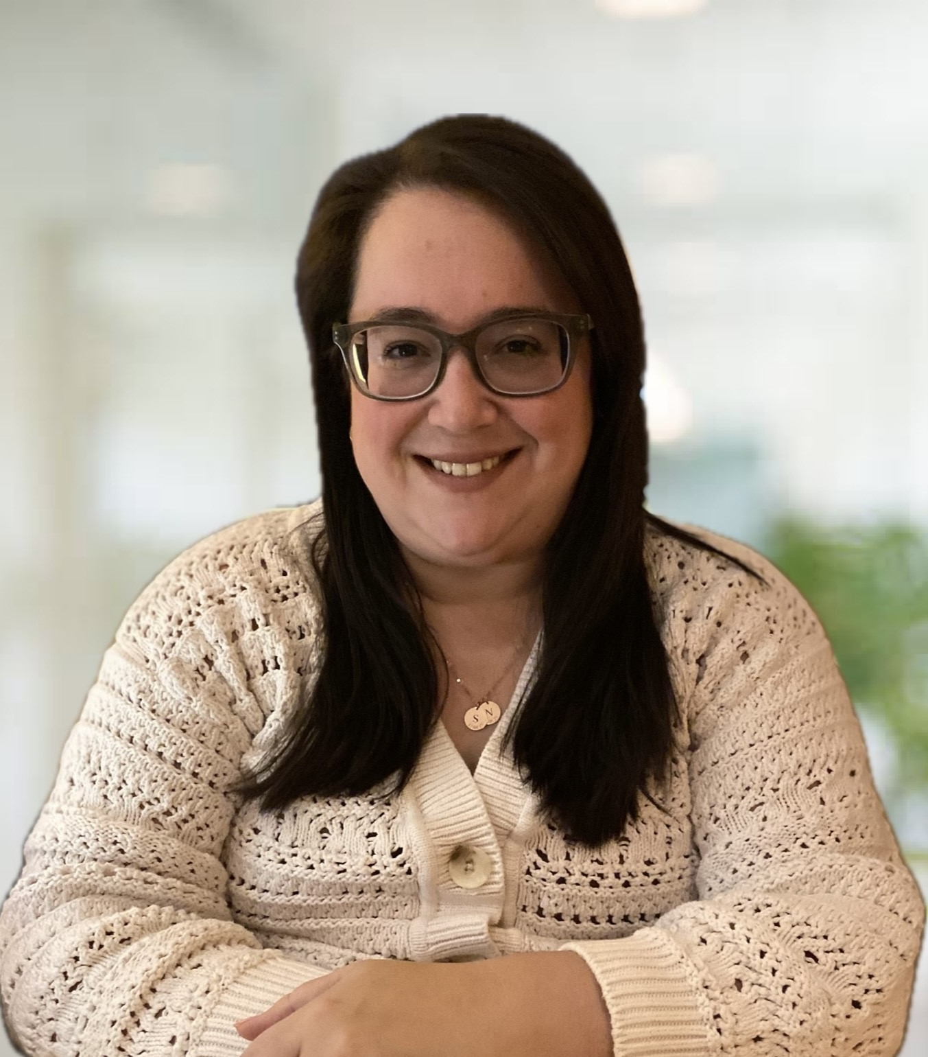
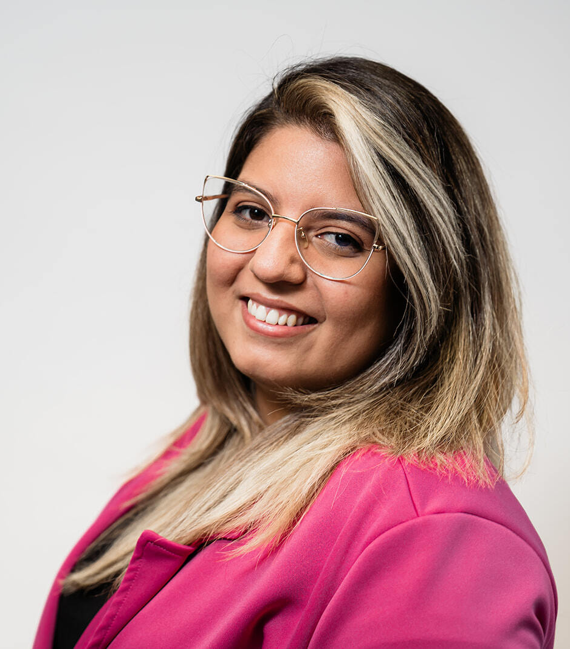
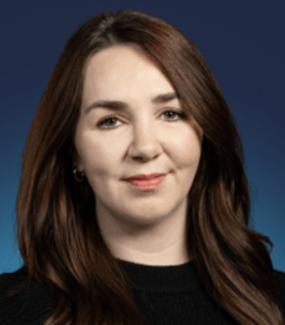

Scholarships
Niagara Community Foundation/Civiconnect- Kirstin Webb
WIN Council - Amy Whittaker
NEXTNiagara – Katrine Stuppiello-Streiss
LN Diversity – Estafania Mariaca
Canada Ontario Job Grant(COJG) - Katie Poissant-Paul, Lauren Cumpson

Slide 12
Thank you

Slide 13

Break

Slide 14
Welcome to #CLDP2425
Follow & Tag

Slide 15
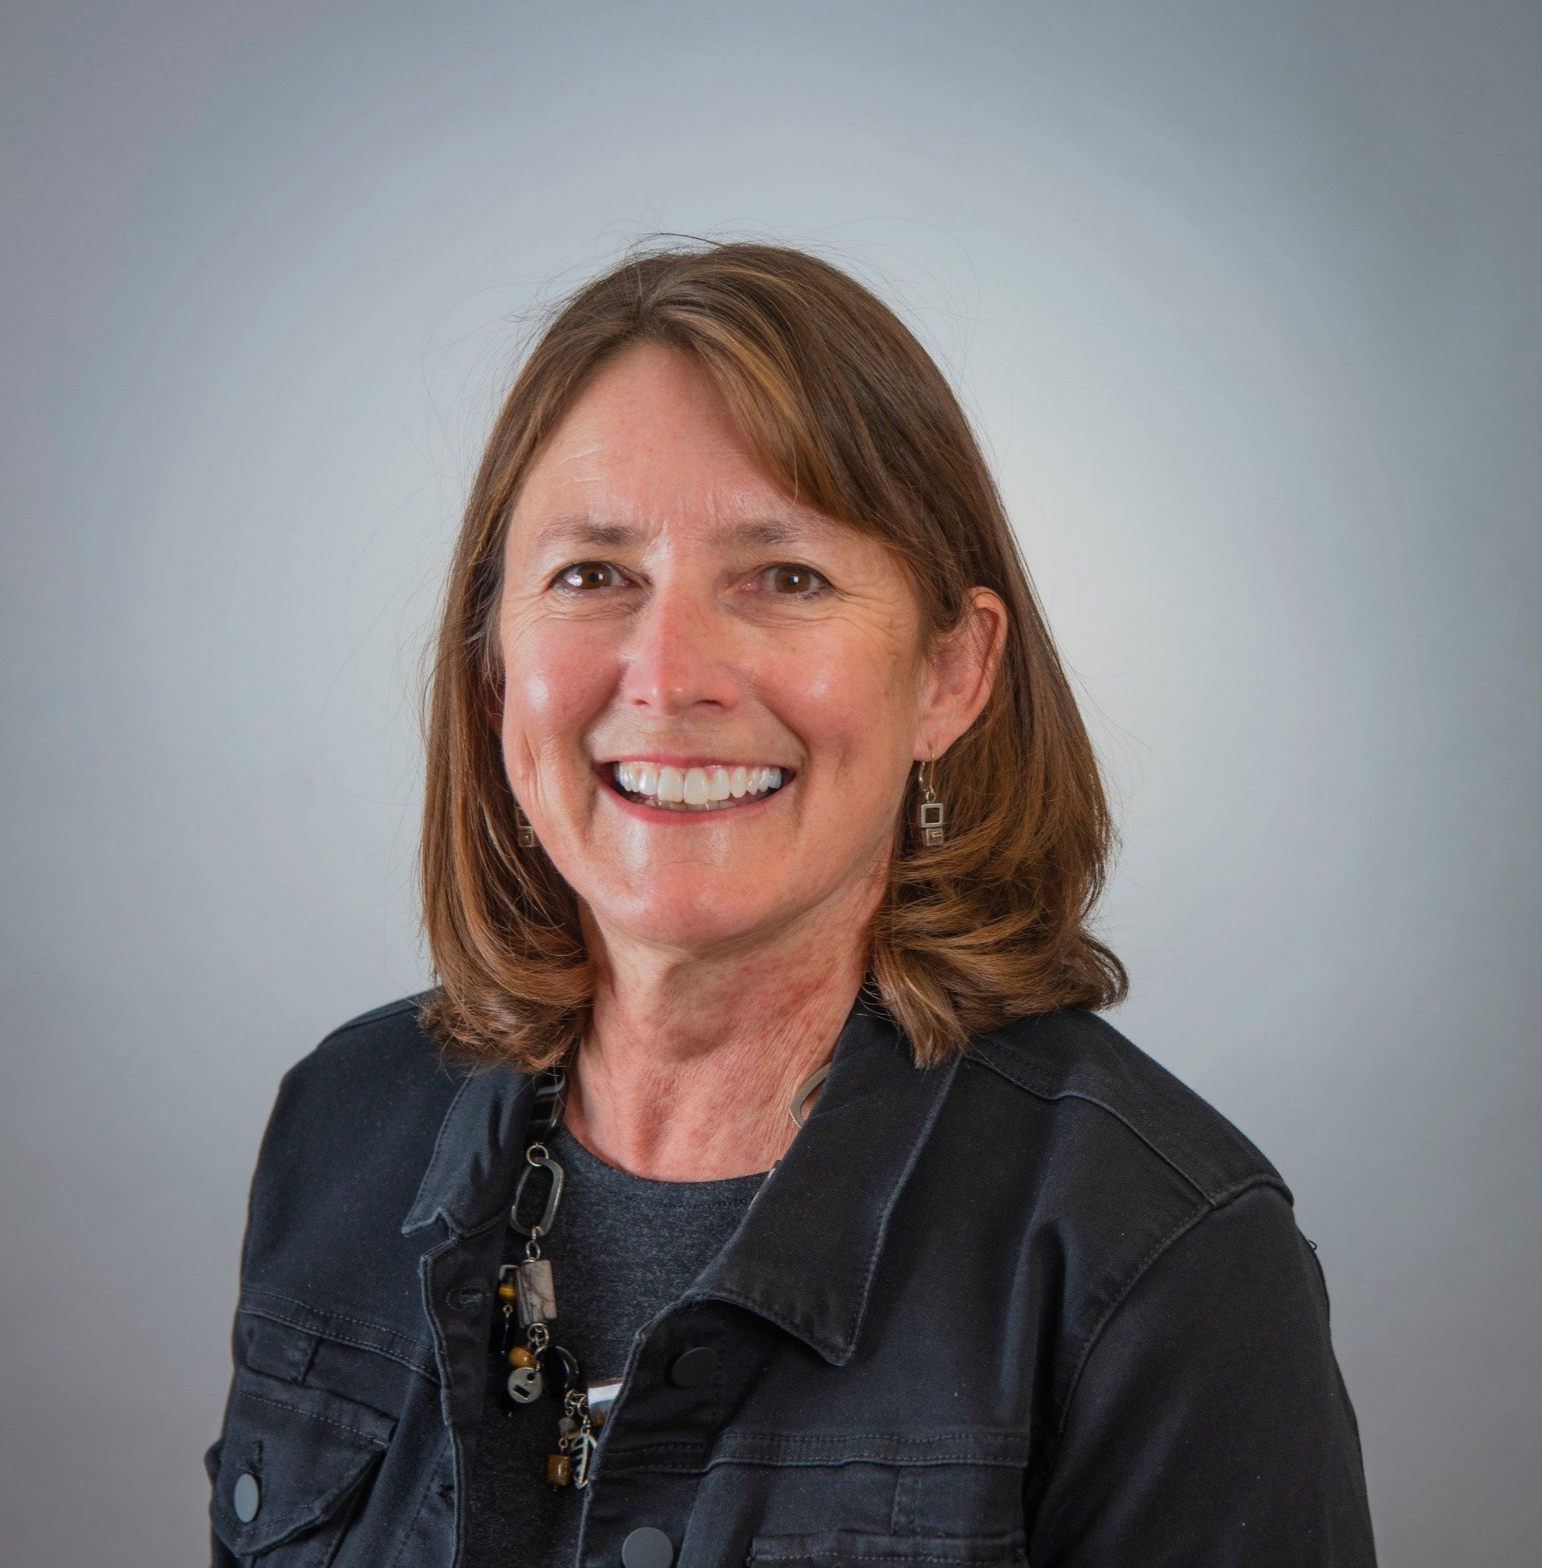
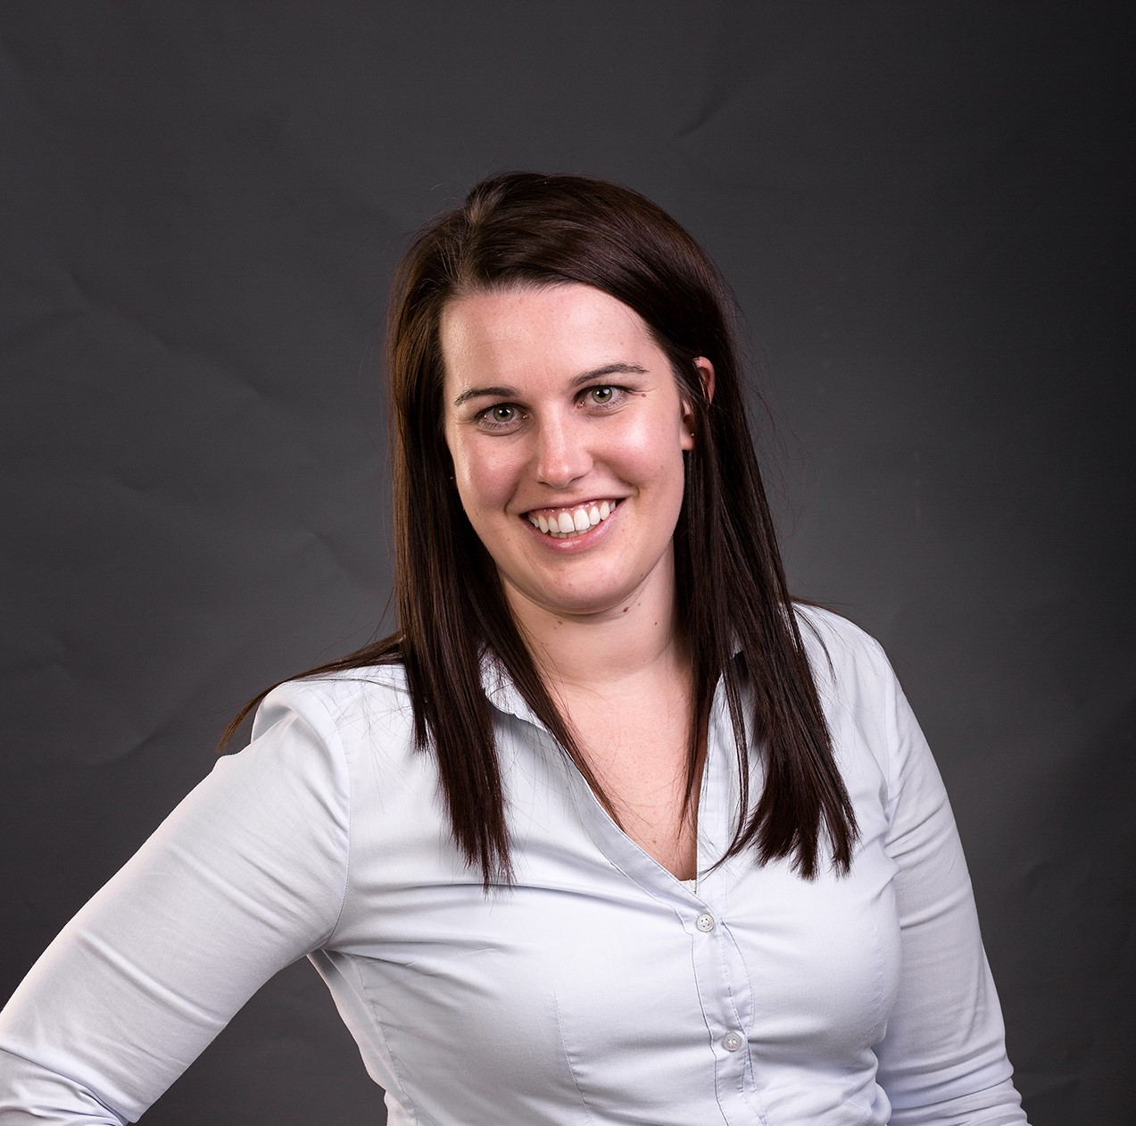
Introductions – Program Advisory Day 1 Committee
Ann Harrison (chair)
Katie McQuestion
Carrie Price
Notes:
Terry introduces

Slide 16
Opening Retreat and Day One
Learning Objectives
Develop an understanding of the Leadership Niagara (LN) journey and all program expectations,
Identify learning goals for their personal and professional growth as a community leader,
Network with LN team members and commence the development of a community of learners,
Examine foundational principles of leadership; analyze and assess one's personal leadership strengths and opportunities,
Explore strategies for maximizing inclusion and leveraging the strengths of self and team, and
Develop an understanding of the Experiential Learning Project requirements and expectations for CLDP
Notes:
Carrie

Slide 17
In the event of illness …
We are all aware that at a moment's notice, circumstances in our personal lives and community may change. With the possibility of an increase in COVID/RSV/Flu possible this fall and winter, please consider the health and well-being of others and stay home if you are sick. We support those who choose to wear masks.
Should you require attending an in-person day virtually please contact Terry Dow as soon as possible.
Notes:
Ann

Slide 18
In the event of inclement weather …
In the event of weather-related cancellation or delay Terry will reach out via email with information and options. We will make every effort to communicate changes by 7:00 a.m. on the learning day.
If the transportation for the local school boards, DSBN and NCDSB is cancelled the Learning Day will be cancelled
May 30th is a scheduled day and will be used for as a make-up day or as a day for additional learning
Notes:
Ann

Slide 19

THE LEADERSHIP NIAGARA JOURNEY

Slide 20
Milestone Moments
Notes:
Katie to review these next slides

Slide 21
EARLY YEARS
2006-2007
  A group of community minded leaders wanted to create a Leadership Development program to encourage and support leaders in Niagara to commit to building a better Niagara
  January 2007, first cohort of participants
2011 – 2016
  Housed at Brock University.
  Program develops to include Experiential Learning focus
2017
  Leadership Niagara branding and full curriculum review completed
  10-year anniversary
2018
  Incorporated as a Not for Profit
  Strategic Plan 2018-2021 created
  Moved to be based at Niagara College

Slide 22
2019-2023
2019-2020
  Last full in person program
  March 2020 sudden pivot to virtual learning
  First virtual graduation
  Summer and Fall 2020 – specialized targeted workshops offered
2020 – 2021
  PAC reworks full curriculum to create ACL+ an abbreviated intense virtual program for Jan – June 2021
2021-2022
  PAC reimagines ACL to be full year virtual program due to COVID
2022-2023
  Program paused to work on Strategic Plan with support from Lake and Associates, full Board of Directors and Program Advisory Committee members involvement
  Extensive Community Consultations
  Strategic Plan released in Spring 2023

Slide 23
2023-Present
2023 – 2024
  PAC reworks curriculum with a renewed alignment to the Strategic Plan
  Renewed commitment to community leadership
  Back to original CLDP branding
  Partial virtual and in person
2024-2025
  A return to fully in person learning

Slide 24
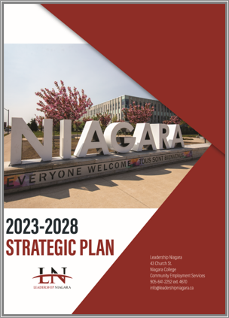
2023 Strategic Plan
Notes:
Ann to review the Strat Plan and process

Slide 25
Our Findings
A return to our roots as a community leadership development program
Still a strong desire in Niagara to develop community leaders
A need to operate differently in an every-changing world
Notes:
1. We heard from the community that the program was valued and needed within Niagara. The post-pandemic world needed strong community voices, and continuing with our core programing would support those voices. The on-going challenge of program access needed to be addressed (financial, acceptance, and time barriers).
2. The program began in 2007 as a community leadership program. Over the years it evolved to a Leadership program that took a civic engagement approach. As with many shifts this one was subtle and driven by a desire to attract participants. What it led to is a loss in focus and direction, that found the program competing with other leadership development program and internal organizational training opportunities.
-Although the program has always and still provides a great place for individuals to develop their leadership skills, we see the main purpose as the development of community leaders.
3. As we learned through the pandemic nothing about the delivery of our program and the focus of our organization would be ever be “business as usual” again! There would be a need to re-imagine not only how we delivered the program but all aspects LN.
It was these three findings that drove the development and focus of our new strategic plan.

Slide 26
Strategic Directions
Positioning: Strategic alignment of the organization
POSSIBILITIES: a sustainable future
PROGRAMMING: community development learning opportunities
PEOPLE: a focus on engaging people
Notes:
POSITIONING: Relationships are central to our collective community approach. Partnering with like-minded organizations that we can collaborate with and learn from will be our focus. We see community-minded organizations and their leaders as a key source of our present and future success. Aligning visions, missions, and values will create an environment that is beneficial to the success of all partners.
POSSIBILITIES: Knowing that our sustainability will be predicated on creating greater access to individuals, there will be a need to shift from our present registration driven approach to funding. We will strive to diversify our funding sources through sponsorship, and registration support that will ensure that the cost of the program is not a barrier to participation. As well we will seek out other opportunities to utilize our expertise in the development of additional revenue streams.
PROGRAMMING: Community leadership and the needs of our participants are ever-evolving. We will continue to review and enhance what we deliver in an effort to meet these needs. As well we will look to new topics and opportunities to deliver more in-depth content on complex issues through supplemental learning opportunities. We will continue to innovate not only on what we deliver but how we do it. Building off of what we have learned over the past three years, we will continue to investigate ways to deliver our core program that supports the busy lives of our participants, while looking at alternative deliveries that will allow for different levels of time commitment from those wishing to participate.
PEOPLE: In a society and region that is becoming increasing diverse it will be important to be an organization that embracing the uniqueness's of our community in what we deliver, how we deliver it, and who is delivering. Access the program that support and represents the growing diversity in Niagara, and diversity of thoughts and views within our Board and Committees will be central to our efforts in this plan. Engaging not only our community partners, but also our over 700 alumni will be central to our future success.

Slide 27

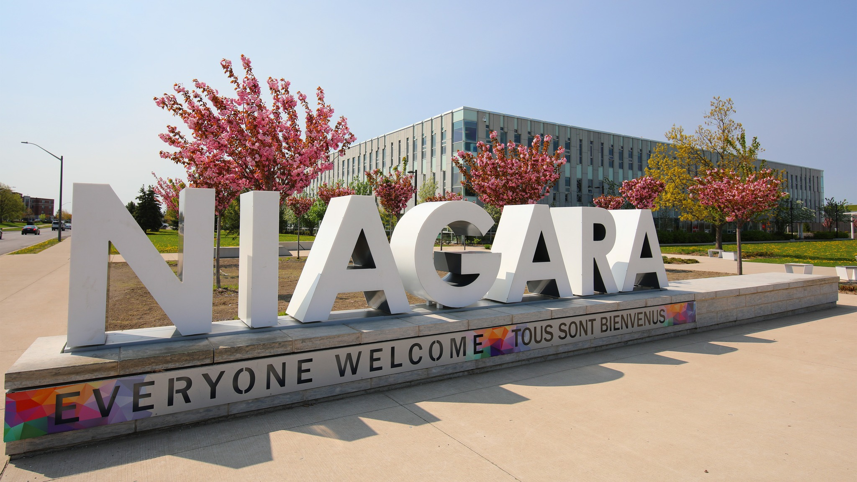
Community Commitment
We commit to empowering our participants to become advocates for a positive change in our community, by encouraging them to engage in service projects, volunteer work, leadership opportunities, and other activities that aid in creating a stronger Niagara.
Notes:
With these aspirations at the centre to what we will do other the next five years, we look for the best way to express that to Niagara. This led us to the development of the following commitment statement:
We commit to empowering our participants to become advocates
for a positive change in our community, by encouraging them to
engage in service projects, volunteer work, leadership opportunities,
and other activities that aid in creating a stronger Niagara.
Thank you, and I would be happy to hear your thoughts and feedback!

Slide 28

Mission and Vision
Mission Statement - Provide diverse learning experiences that will inspire leadership and contribute to a vibrant, prosperous, community-minded Niagara.
Vision - Inspiring Leaders. Building Community.

Slide 29




CORE VALUES
Engagement
Collaboration
Creativity
Authenticity
Community involvement, that creates an inclusive environment for our partners that builds and strengthens relationships
Working together in a respectful and purposeful way, to achieve a common goal
Embracing innovative and imaginative approaches with passion and desire, that creates transformative and impactful ideas
Sincerity and honesty, displayed in a non-judgmental and values-based to actions and activities

Slide 30
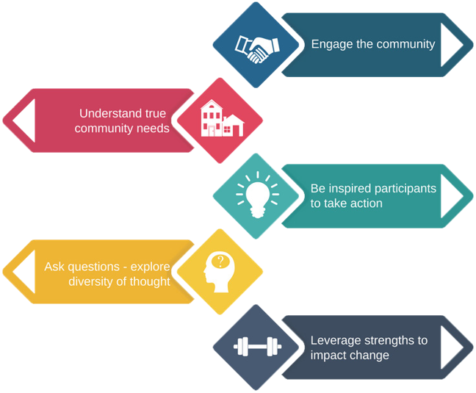
LEADERSHIP NIAGARA PILLARS

Slide 31

Community Leadership Development Program – Learning Objectives
Our Community Leadership Development program:
develops the capabilities of aspiring leaders who care about the community
encourages community leadership for positive change within the Niagara region
has an experiential learning component
Is founded on best practices of exemplary community leaders
Notes:
Carrie

Slide 32

Learning Objectives Cont'd
During this program we intend to focus on the challenges and opportunities facing Niagara and:
explore and contribute to a changing landscape
challenge our personal views
identify opportunities for change
examine the power of community and leadership
Notes:
Carrie

Slide 33
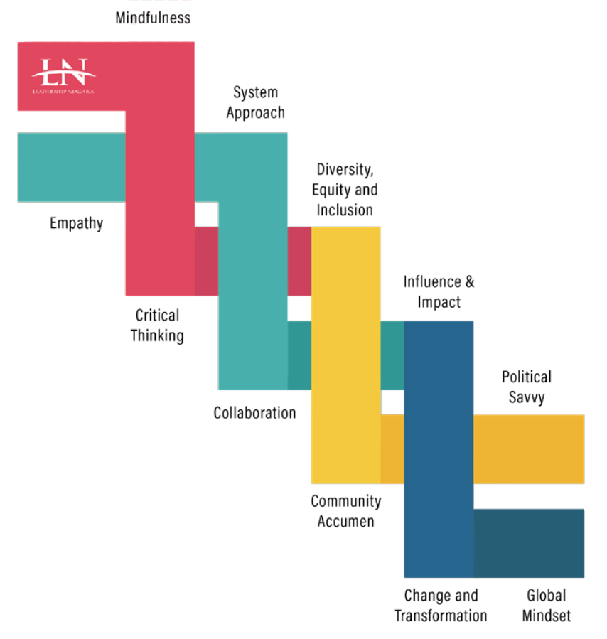
COMPETENCY
FRAMEWORK
DNA
Text
Title
Text
Title
Text
Title
Notes:
Ann Notes – ensure that we highlight that LN has developed a series of competencies which benefit all community leaders – just as these competencies are woven together as a DNA framework for leaders, so too does the PAC ensure that these are woven into the fabric of our learning days ----
ACTIVITY - (if time allows) - At this point in your learning journey what do you understand about this competency?
Table talk instead – handout of the framework – which ones resonate with you, which do you not know.... Debrief -

Slide 34
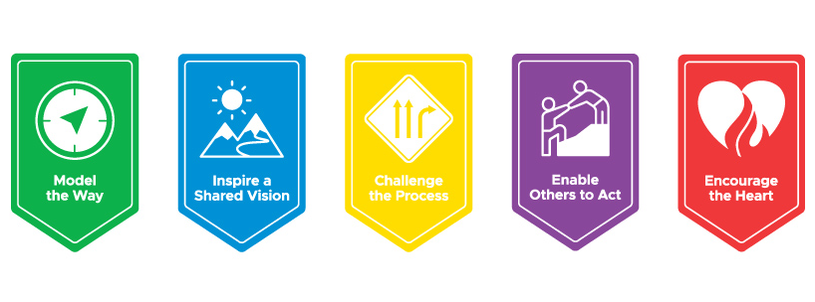
The Five Practices of Exemplary Leadership
The Leadership Challenge, J Kouzes and B. Posner, 2023
Notes:
Ann
There are so very many books on leadership – as an organization the LN PAC has chosen the Leadership Challenge by Kouzes and Posner – this is not a text book for us but instead acts as a framework – community leaders who work to refine and develop these exemplary practices, show great success in their roles. Again the PAC works to link each learning day to these and works to model these practices in our lives. On our full Day One – Dr. Holly Catalfamo will lead us through an exploration of these five practices.
We will have a guest speaker on Day One review this information in greater detail.

Slide 35
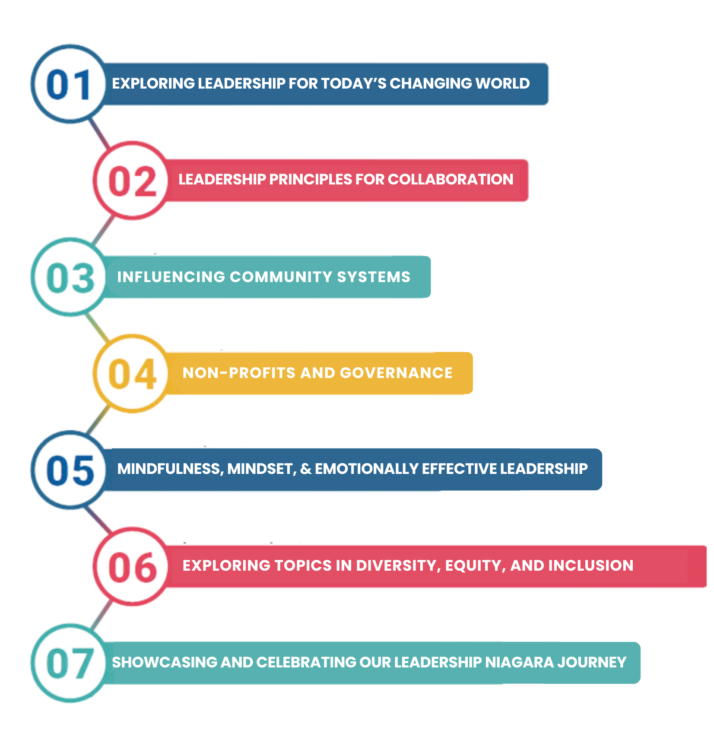
CURRICULUM ROADMAP
Text
Title
Notes:
Katie does next three

Slide 36
The Five Practices of Exemplary Leadership
The Leadership Challenge, J Kouzes and B. Posner, 2023
Notes:
Ann
There are so very many books on leadership – as an organization the LN PAC has chosen the Leadership Challenge by Kouzes and Posner – this is not a text book for us but instead acts as a framework – community leaders who work to refine and develop these exemplary practices, show great success in their roles. Again the PAC works to link each learning day to these and works to model these practices in our lives. On our full Day One – Dr. Holly Catalfamo will lead us through an exploration of these five practices.
We will have a guest speaker on Day One review this information in greater detail.

Slide 37
COMPETENCY FRAMEWORK
Days One - Three
Day One: Exploring Leadership for Today’s Changing World
      LN Competencies: Empathy, Community Acumen, Change/Transformation
      Introduction to the K and P Framework
Day Two: Leadership Principles for Collaboration
LN Competencies: Critical Thinking, Collaboration, Community Acumen, Change/Transformation
K and P Framework: Challenge the Process, Encourage the Heart
Day Three: Influencing Community Systems
LN Competencies: Systems Approach, Collaboration, Influence and Impact, Political Savvy, Change/Transformation
K and P Framework:
Text
Title
Text
Title
Text
Title

Slide 38
COMPETENCY FRAMEWORK
Days Four to Seven
Day Four: Non-Profits and Governance
LN Competencies Influence & Impact, Political Savvy, Community Acumen
K and P Framework: Enable Others to Act, Challenge the Process, Model the Way
Day Five: Mindfulness, Mindset, & Emotionally Effective Leadership
LN Competencies: Mindfulness, Influence and Impact, Change/Transformation
K and P Framework: Model the Way, Encourage the Heart
Day Six: Exploring Topics in Diversity, Equity and Inclusion in Niagara
LN Competencies: Diversity, Equity and inclusion; Community Acumen, Change Transformation
K and P Framework: Challenge the Process, Model the Way, Encourage the Heart
Day Seven: Showcasing and Celebrating Our Leadership Niagara Journey
LN Competencies: Touching on all
K and P Framework: Encourage the Heart
Text
Title
Text
Title
Text
Title

Slide 39

Let’s Play Bingo
Notes:
Carrie
Provide instructions for our BINGO Icebreaker which will allow participants to walk around, complete a card and then we hold a debrief =

Slide 40

Break
Notes:
5 to 10 minute break

Slide 41
The Community Project
The Community Project is modelled on Action Research. It provides a direct link between the Community Leadership Development participants and our not-for-profit community partners.
The projects allow our participants to support local organizations by
Bringing fresh outlooks to their team
Providing creative ideas for addressing their challenge or project
Applying expertise from diverse professional backgrounds
Through identifying, developing and executing critical projects in a community collaboration.
Notes:
Start of 30-40 minutes – check agenda and info from Brian

Slide 42
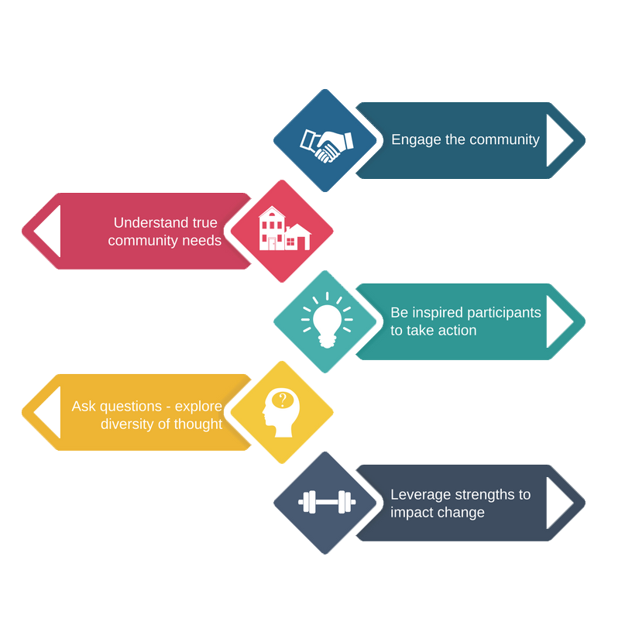
Objectives of Community Leadership
Notes:
The goal of the project is to develop a greater skill at reviewing needs, asking questions, engaging with the partner with the goal to leverage changes.

Slide 43
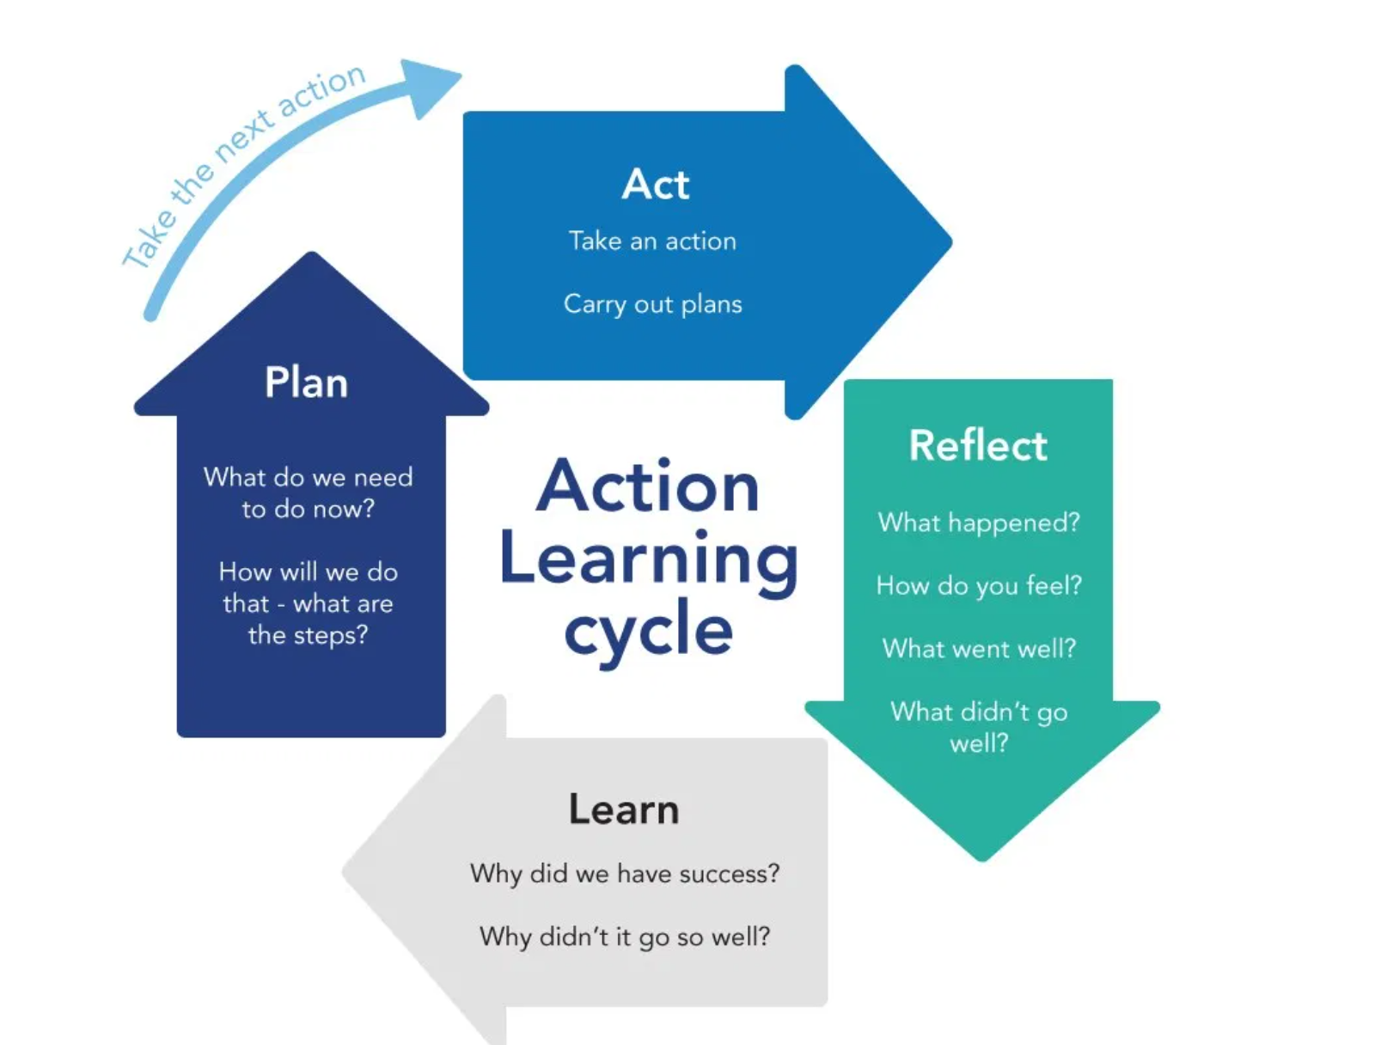
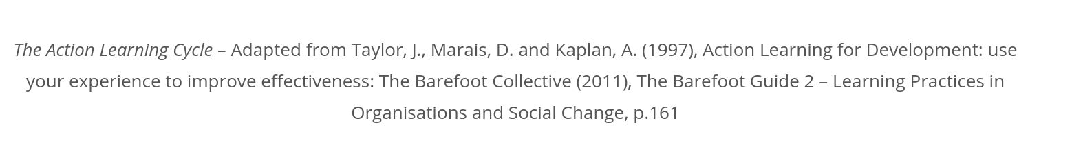
Action Learning
Your Action Learning Project with the Community Partner will allow you to apply and reflect on what you have learnt throughout the Learning Days in the Program
Notes:
The Action Learning cycle will allow all of your to make a plan with your community partner, you will then work on that plan and then reflect on what worked and didn't work, learning from this reflection is a critical piece of determining how to modify the plan for continuous improvement. We hope that you can take some of the leadership attributes you are learning and use them as a reflective tool in the process.

Slide 44

Apply the learnings from the CLDP program to a real situation in Niagara to become effective change leaders
Develop an increased understanding of Niagara’s communities, people and sectors
Collaborate with a diverse group of community leaders
Develop your personal community leadership acumen
Gain an understanding of a local not-for-profit organization, learn about its role in supporting the local community, and understand the challenges and opportunities they face.
Notes:
This slide can just be read/summarized

Slide 45
This Year's Projects
This year we are excited to have five community projects submitted:
Wellspring Niagara
Big Brothers, Big Sisters of Niagara
Positive Living Niagara
REACH Niagara
Withdrawal Management Services (WMS)
Or your own Passion Project – this can be something you are currently working on our wish to work on to help a community not for profit. Grab a new friend and work on it together.
Notes:
Wellspring Niagara ( a cancer support facility)– support for a financial sustainability plan
Big Brothers Big Sisters (pairing adults with young boys and girls to provide mentorship)– support for engaging community members/employees to become active volunteers
Positive Living Niagara (a support network for those living with blood borne diseasese such as HIV and Hep C) – Support their work in adapting and renewing their Strategic Plan
REACH Niagara – support for planning a community appreciation event
Withdraw Management Services (supportive care for those experiencing withdrawal from alcohol and substances) -client engagement support ideas and funding
Passion Project – do you have a particular not for profit or community group you are currently supporting which you wish to have a group assist you with – is there a topic that you wish to explore in greater detail to see how to promote this in Niagara.

Slide 46
Deliverables
At the end of our Community Leadership Development Program, your Project Team will create and share with all of us a presentation that summarizes your project. You may wish to include:
Who did you work with and what was their challenge or problem for which they wanted support?
What were some of your goals and the actions you took to reach those goals?
Where did you experience success and where did you have some challenges?
What reflections did you have as a group or personally?
What are some of your learnings about community leadership in Niagara?
How might you transfer this to action once the program is completed?
Notes:
Remember that it is possible that in the short time frame provided your project may not be finished. It also make take a u turn or shift focus or direction. As you move through the program, you will learn that many not for profits rely on grants for operating – if a grant isn't renewed then sometimes staff are sidelined into other positions meaning the person you are working alongside is no longer your connections

Slide 47
The Process
Between Day One and Day Two
Review the Summary Notes for each Project (uploaded to the website)
On Day Two
Leads will be present on Day Two to respond to questions
Participants will rank their choices
Project teams will be created and shared with the group
Notes:
Please remember that all projects should get supported by a team – and that you may not all get your first choice in projects. We also want to ensure that you stretch yourself – test out something completely outside your area of expertise – it is through challenging ourselves that we grow.

Slide 48

Notes:
The projects are worked on during your own timeframe – they are above and beyond the scope of our learning days. We will have some small amounts of time to check in on learning days or to allow you to meet following a learning day to discuss topics.
Final presentations are made on Day 7 – Friday, June 13th

Slide 49

Questions?

Slide 50
Letter to Self
Questions to consider:
What does community leadership mean to you?
What do you hope to achieve through your participation in this program?
Where do you hope to grow as a leader?
Notes:
We have covered a lot of material today and hopefully you are excited to participate in this learning journey with us.
We consider the CLDP program to be a learning journey about community leadership.
Take a moment or two to think about all that we have talked about and where you are in your personal leadership journey. Perhaps think about how community leadership may be the same or different from leadership in your workplace?
Now we are going to give you 10-15 minutes to write a letter to your self answering the questions on the screen. We would ask that you sign and seal your letter, place your name on the outside and then bring the envelop up to the front – you will be get this letter back on Day 7

Slide 51
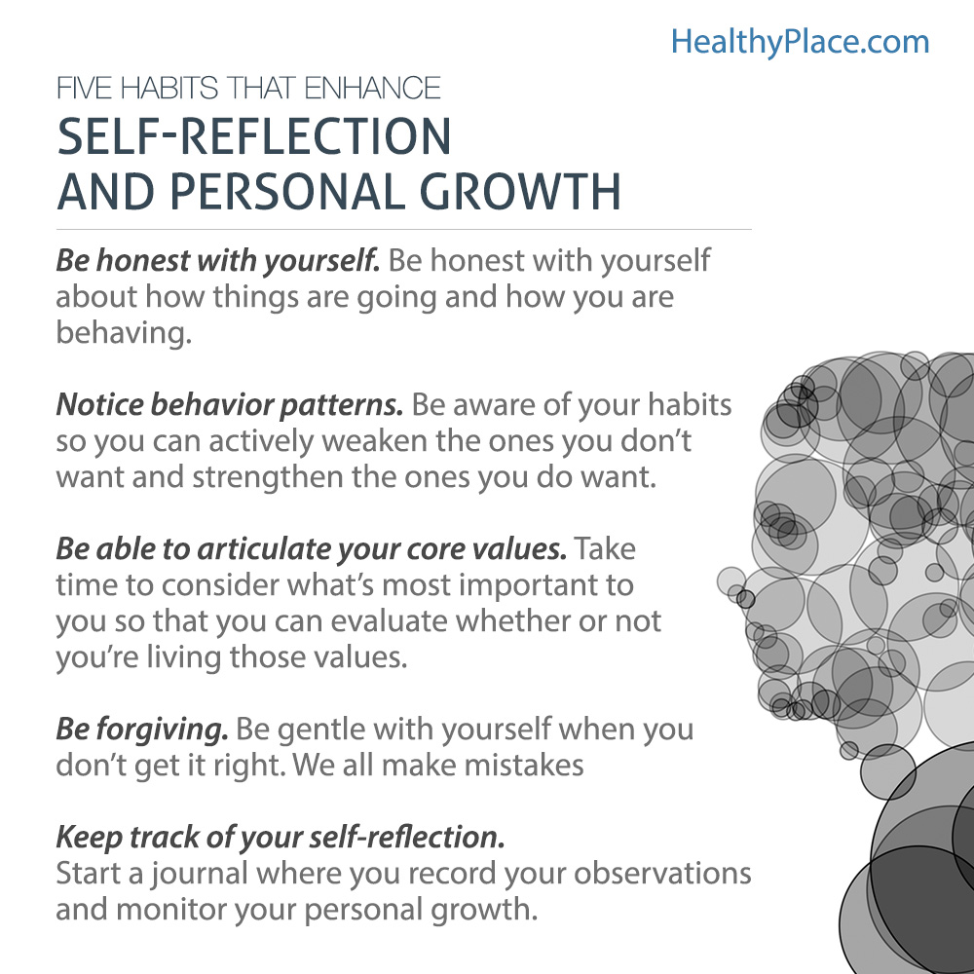
Notes:
This page should be in the portfolio – as they write their letter to self and then moving forward as they write reflections throughout the program these are some habits that are good to keep in mind. Remember that growing as a leader requires that you reflect on your own practice in an authentic and honest fashion.

Slide 52
Personal Assessments
Leadership Practices Inventory (LPI)
  We will complete this now and again at the end of the program
  Dr. Holly Catalfamo will be presenting next week on the K and P framework so be sure to bring this with you.
  Tetramaps
  On Day One, Shane Malcolm will be leading us through a personality assessment called Tetramaps – you will be sent an electronic token to complete this assessment prior to Day One.
Notes:
One of the aspects of our program is a review of you own approach to leading and working collaboratively with others. While there are many personality assessments out there we have you do two for the first day of learning. One is based on The Leadership Challenge by Kouzes and Posner – the other is based on a personality assessment called Tetramaps which we hope you have not yet encountered. You should have a copy of the LPI in your portfolio and we would like you to take some time to complete this now.

Slide 53
Be Prepared, for Day One
Day One Information and Update
Terry Dow, Executive Director

Slide 54
Things to do for Day One
Complete the LPI and Tetramap assessment
Location: Accursi Room, Fonthill Meridian Community Centre
Rice Road and Hwy 20
A light lunch will be provided
Bring a refillable water bottle and your portfolio
Review all emails from Terry with instructions on work to be completed
Be sure to complete the Survey as this informs our planning

Slide 55
You are cordially invited to:
Day One Social @
Next Kitchen + Bar
200 Highway 20 E, Fonthill after the conclusion of Day One, Friday, October 25th

